Slide 1
Application Delivery Fundamentals 2.0 B: Java
Spring Security

Slide 2
Goals
User credentials are sent in clear / easy to decode format
Apply Salted Hash technique on the password.
Session Fixation
Follow a secure session management lifecycle which includes proper initialization, maintenance, authentication and termination of the session token.
Host Header Attack
The web application should use the SERVER_NAME instead of the Host header.

Slide 3
Goals
HTML Injection
Implement validations to escape all html tags and special characters from the user supplied input.
Reflective Cross Site Scripting
The best way to prevent cross-site scripting is to make sure that the web application does not make use of user input in the subsequent HTML pages, without validating or sanitizing it .

Slide 4
Goals
Authorization Bypass
Maintain proper authorization schema.
Improper error handling
Create a default error handler which returns an appropriately sanitized error message for most users in production for all error paths.
Vulnerable Remember Password
Ensure that no credentials are stored in clear text or are easily retrievable in encoded or encrypted forms in cookies.

Slide 5
Goals
Vulnerable Javascript library
Missing Security Headers
Session Hijacking
Unused Ports/Services
LUCKY13
Possible Bruteforce Attack
HTML / iFrame Injection

Slide 6
Java SE Security Mechanisms
Java Authentication and Authorization Service (JAAS)
Java Generic Security Services (Java GSS-API)
Java Cryptography Extension (JCE)
Java Secure Sockets Extension (JSSE)
Simple Authentication and Security Layer (SASL)

Slide 7
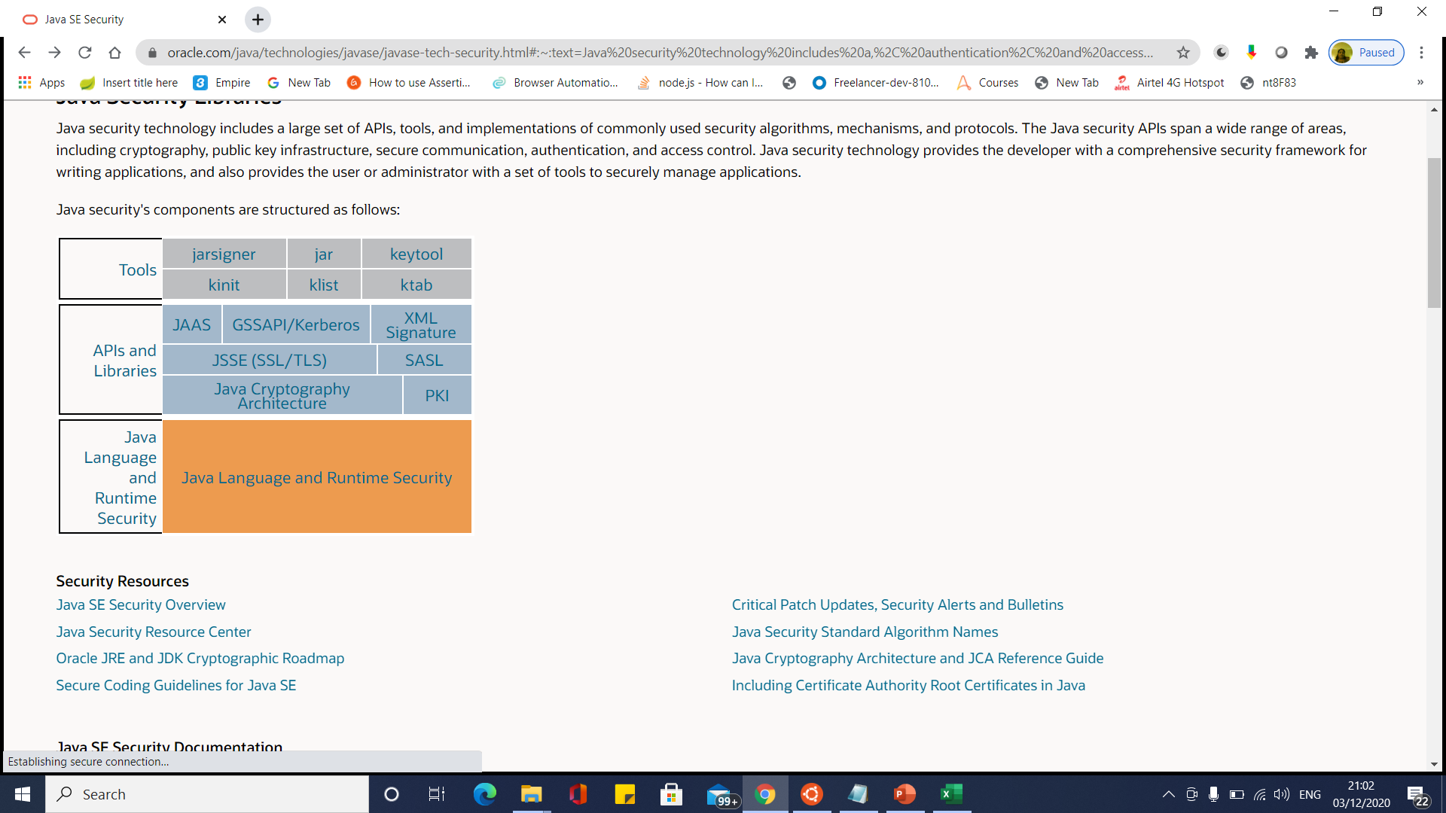
Java SE Security Mechanisms

Slide 8
Jar Signer
jarsigner -verbose -sigalg SHA1withRSA -digestalg SHA1 -keystore my-release-key.keystore my_application.apk alias_name

Slide 9
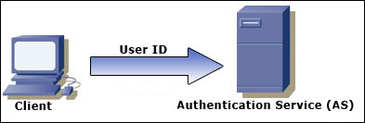
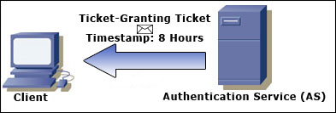
Kerberos

Slide 10
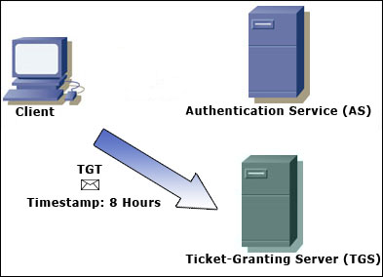
Kerberos

Slide 11
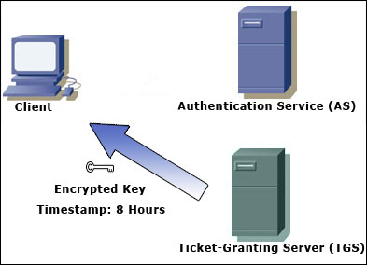
Kerberos

Slide 12
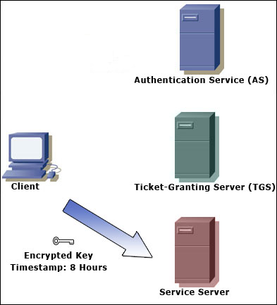
Kerberos

Slide 13
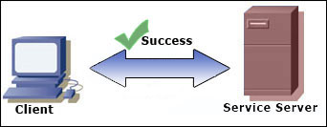
Kerberos

Slide 14
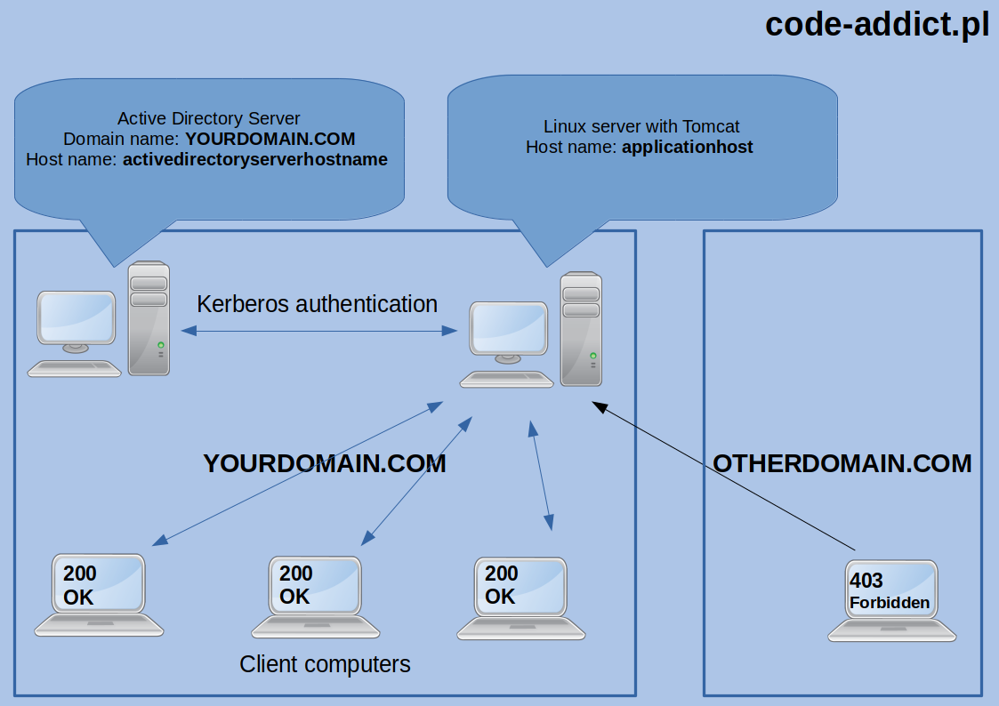
Kerberos

Slide 15
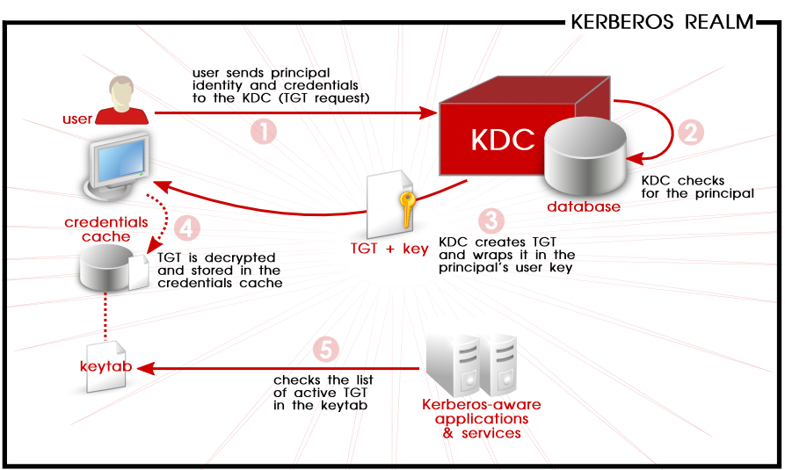
Kerberos

Slide 16
Java SE Security Mechanisms
High-level Features | Low-level Features | Benefits
Platform Security | Built-in language security features enforced by the Java compiler and virtual machine: Strong data typing Automatic memory management Bytecode verification Secure class loading | Provides a safe and secure platform for developing and running applications. Compile-time data type checking and automatic memory management leads to more robust code and reduces memory corruption and vulnerabilities. Bytecode verification ensures code conforms to the JVM specification and prevents hostile code from corrupting the runtime environment. Class loaders ensure that untrusted code cannot interfere with the running of other Java programs.

Slide 17
Java SE Security Mechanisms
High-level Features | Low-level Features | Benefits
Cryptography | Comprehensive API with support for a wide range of cryptographic services including digital signatures, message digests, ciphers (symmetric, asymmetric, stream & block), message authentication codes, key generators and key factories Support for a wide range of standard algorithms including RSA, DSA, AES, Triple-DES, SHA, PKCS5, RC2, and RC4. PKCS#11 cryptographic token support | Provides an extensible, full featured API for building secure applications: Algorithm and implementation independent Provider-based (pluggable) architecture

Slide 18
Java SE Security Mechanisms
High-level Features | Low-level Features | Benefits
Authentication and Access Control | Abstract authentication APIs that can incorporate a wide range of login mechanisms through a pluggable architecture. A comprehensive policy and permissions API that allows the developer to create and administer applications requiring fine-grained access to security-sensitive resources. | Enables single sign-on of multiple authentication mechanisms and fine-grained access to resources based on the identity of the user or code signer. Support for timestamped signatures makes it easier to deploy signed code by avoiding the need to re-sign code when the signer's certificate expires.

Slide 19
Java SE Security Mechanisms
High-level Features | Low-level Features | Benefits
Secure Communications | JSSE standard API, available in the javax.net and javax.net.ssl packages, which provides secure sockets for client and server-side applications, a non-blocking engine for producing and consuming streams of TLS/DTLS data, and key and trust manager interfaces. | Authenticates peers over an untrusted network and protects the integrity and privacy of data transmitted between them.

Slide 20
Java SE Security Mechanisms
High-level Features | Low-level Features | Benefits
Secure Communications | A JSSE provider named SunJSSE that provides cryptographic services including: SSL 3.0, TLS (versions 1.0, 1.1, 1.2, and 1.3), and DTLS (versions 1.0 and 1.2) security protocols Implementations of TLS and DTLS cipher suites, an X.509-based key manager and an X.509-based trust manager. . | Authenticates peers over an untrusted network and protects the integrity and privacy of data transmitted between them.

Slide 21
Java SE Security Mechanisms
High-level Features | Low-level Features | Benefits
Secure Communications | The Java GSS-API, which provides uniform access to security services on a variety of underlying security mechanisms, including Kerberos. The Java Simple Authentication and Security Layer (SASL), which specifies a protocol for authentication and optional establishment of a security layer between client and server applications | Authenticates peers over an untrusted network and protects the integrity and privacy of data transmitted between them.

Slide 22
Java SE Security Mechanisms
High-level Features | Low-level Features | Benefits
Public Key Infrastructure (PKI) | Tools for managing keys and certificates and comprehensive, abstract APIs with support for the following features and algorithms: Certificates and Certificate Revocation Lists (CRLs): X.509 Certification Path Validators and Builders: PKIX, Online Certificate Status Protocol (OCSP) KeyStores: PKCS#11, PKCS#12 Certificate Stores (Repositories): LDAP, java.util.Collection | Eases the development and deployment of complex PKI applications. Support for OCSP provides a more scalable and timely method for applications to check certificate revocation status.

Slide 23
Java Cryptography Architecture
The Java Cryptography Architecture (JCA) is a major piece of the platform, and contains
a "provider" architecture and a set of APIs for digital signatures
message digests (hashes)
certificates and certificate validation
encryption (symmetric/asymmetric block/stream ciphers)
key generation and management, and secure random number generation.

Slide 24
Java Cryptography Architecture

Slide 25
Java Cryptography Design Principles
Algorithm independence
– specification of engine classes
● Algorithm extensibility
– easy updation of engine classes with new
algorithms
● Implementation independence
– use of cryptographic service providers
● Implementation interoperability
– providers working with each other

Slide 26
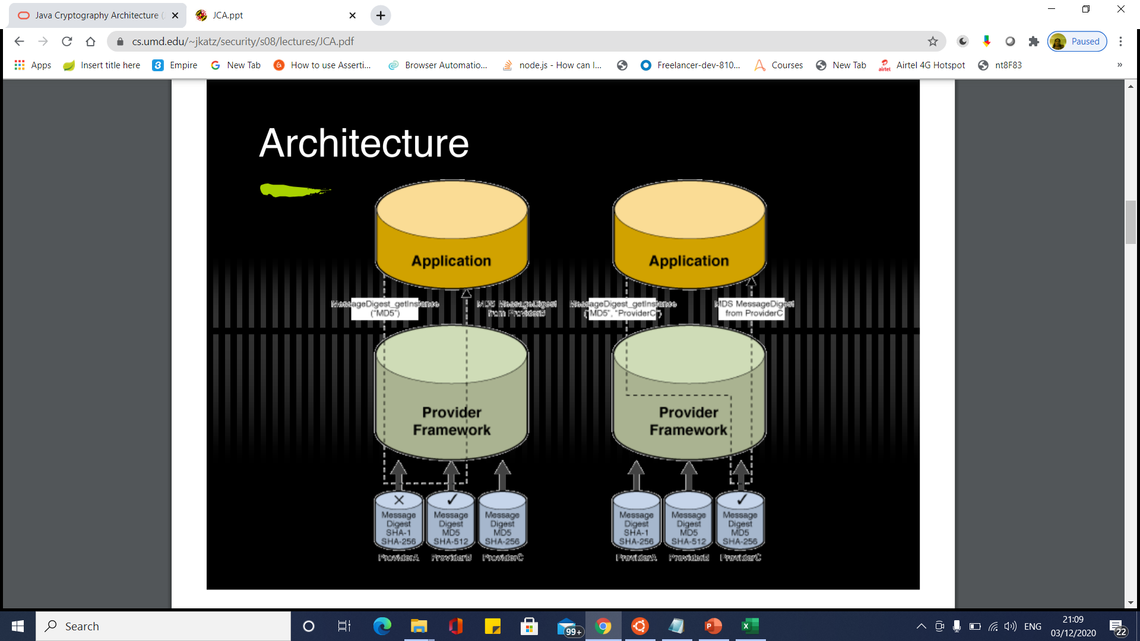
Java Cryptography Architecture

Slide 27
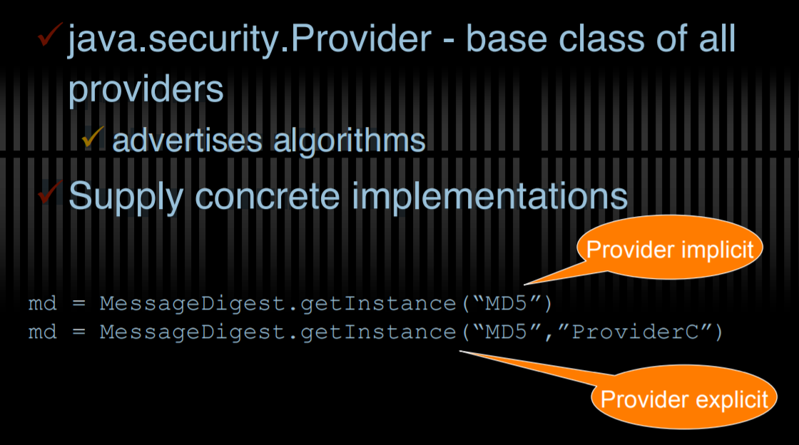
Providers

Slide 28
JCA Engine Classes
Provide the interface to a specific type of cryptographic service
cryptographic operatoins
generators or converers of cryptographic material
objects (keystores or certificates)

Slide 29
JCA Engine Classes
MessageDigest (produces hash value)
● Signature (produces digital signature)
– KeyPairGenerator (produces pair of keys)
● KeyFactory (breaks down a key)
● KeyStore (manages and stores keys)
● SecureRandom (produces random numbers)
– AlgorithmParameters (encoding and decoding)
– AlgorithmParameterGenerator (generates parameters)
● CertificateFactory (public key cert, revocation)
● CertPathBuilder (establish relationship chains between certs)
● CertStore (stores certificates and revocation lists)

Slide 30
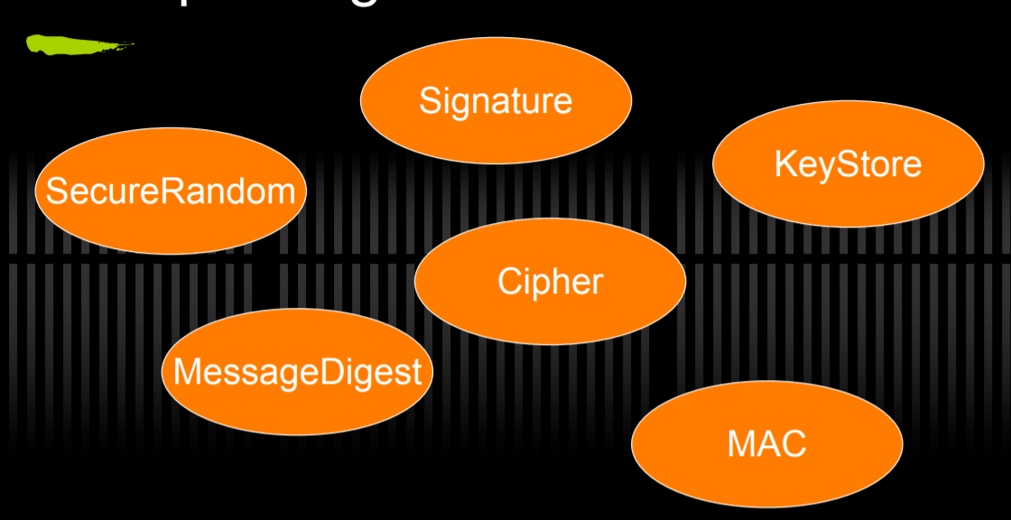
JCA Engine Classes

Slide 31
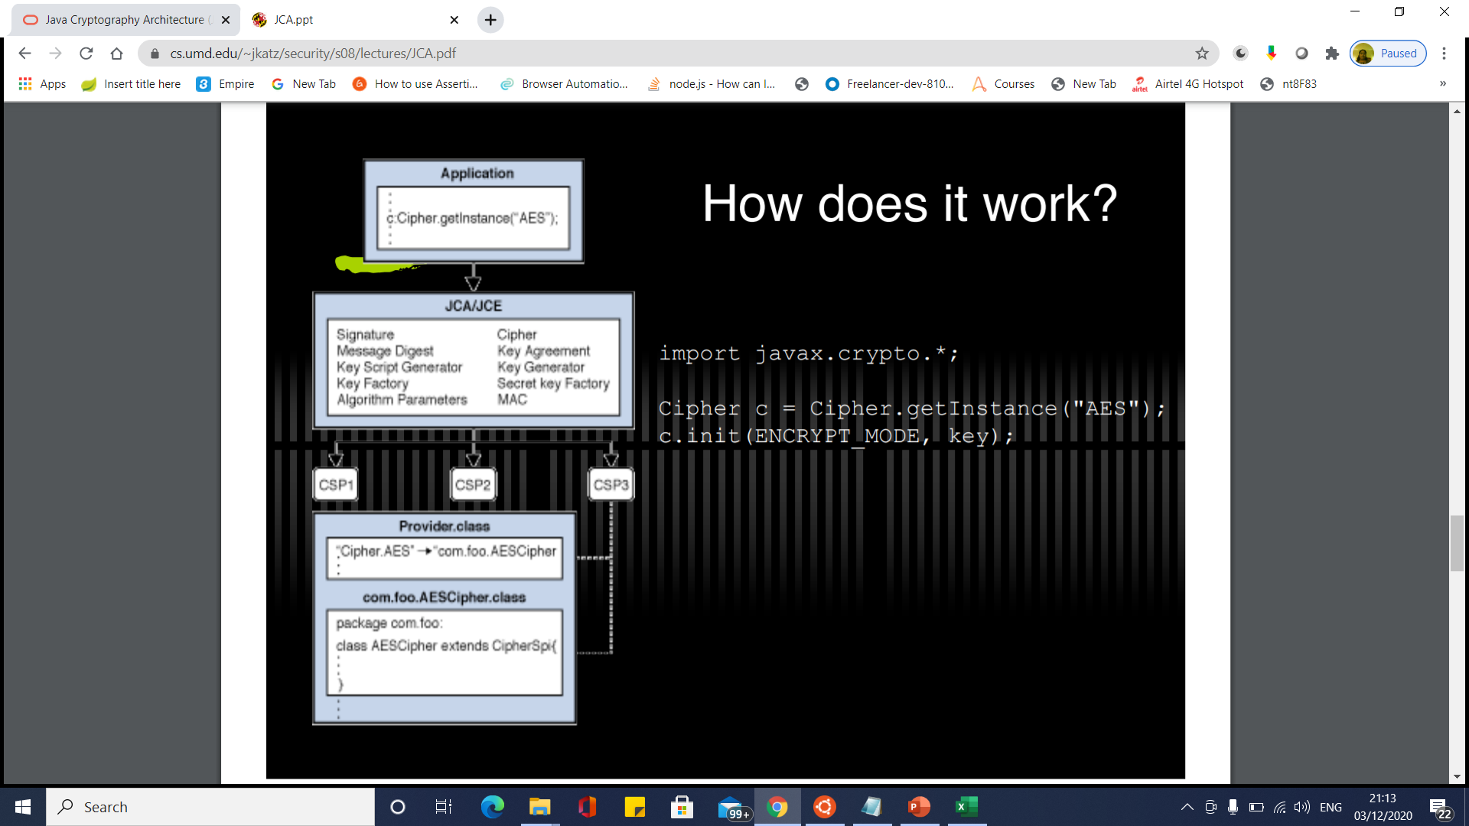
JCA Engine Classes

Slide 32
Secure Random

Slide 33
Message Digest

Slide 34
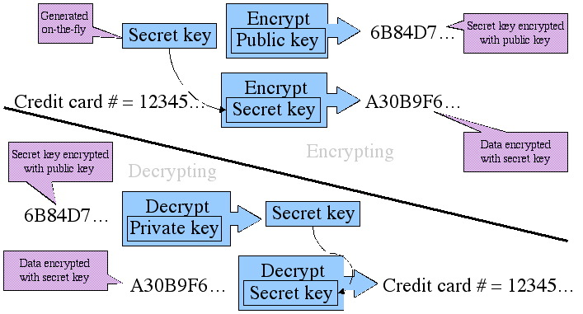
Java Cryptography Extension

Slide 35
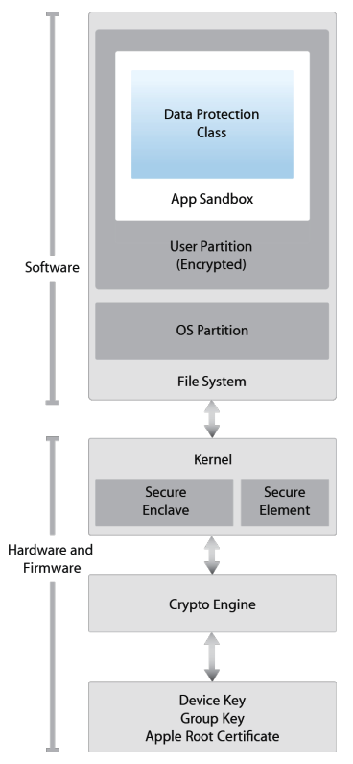
iOS Security Architecture
The iOS security architecture, officially documented by Apple in the iOS Security Guide, consists of six core features. This security guide is updated by Apple for each major iOS version:
Hardware Security
Secure Boot
Code Signing
Sandbox
Encryption and Data Protection
General Exploit Mitigations

Slide 36
iOS Security Architecture
Hardware Security
Each iOS device comes with two built-in Advanced Encryption Standard (AES) 256-bit keys.
The device’s unique IDs (UIDs) and a device group IDs (GIDs) are AES 256-bit keys fused (UID) or compiled (GID) into the Application Processor (AP) and Secure Enclave Processor (SEP) during manufacturing.
There's no direct way to read these keys with software or debugging interfaces such as JTAG.
Encryption and decryption operations are performed by hardware AES crypto-engines that have exclusive access to these keys.

Slide 37
iOS Security Architecture
Hardware Security
The GID is a value shared by all processors in a class of devices used to prevent tampering with firmware files and other cryptographic tasks not directly related to the user's private data.
UIDs, which are unique to each device, are used to protect the key hierarchy that's used for device-level file system encryption. Because UIDs aren't recorded during manufacturing, not even Apple can restore the file encryption keys for a particular device.

Slide 38
iOS Security Architecture
Hardware Security
To allow secure deletion of sensitive data on flash memory, iOS devices include a feature called Effaceable Storage.
This feature provides direct low-level access to the storage technology, making it possible to securely erase selected blocks.

Slide 39
iOS Security Architecture
Secure Boot
When an iOS device is powered on, it reads the initial instructions from the read-only memory known as Boot ROM, which bootstraps the system.
The Boot ROM contains immutable code and the Apple Root CA, which is etched into the silicon chip during the fabrication process, thereby creating the root of trust.
Next, the Boot ROM makes sure that the LLB's (Low Level Bootloader) signature is correct, and the LLB checks that the iBoot bootloader's signature is correct too.
After the signature is validated, the iBoot checks the signature of the next boot stage, which is the iOS kernel.
If any of these steps fail, the boot process will terminate immediately and the device will enter recovery mode and display the restore screen.
However, if the Boot ROM fails to load, the device will enter a special low-level recovery mode called Device Firmware Upgrade (DFU).

Slide 40
iOS Security Architecture
Secure Boot
This is the last resort for restoring the device to its original state.
In this mode, the device will show no sign of activity; i.e., its screen won't display anything.
This entire process is called the "Secure Boot Chain". Its purpose is focused on verifying the boot process integrity, ensuring that the system and its components are written and distributed by Apple.
The Secure Boot chain consists of the kernel, the bootloader, the kernel extension, and the baseband firmware.

Slide 41
iOS Security Architecture
Code Signing
Apple has implemented an elaborate DRM system to make sure that only Apple-approved code runs on their devices, that is, code signed by Apple.
In other words, you won't be able to run any code on an iOS device that hasn't been jailbroken unless Apple explicitly allows it.
End users are supposed to install apps through the official Apple's App Store only.
For this reason (and others), iOS has been compared to a crystal prison.
A developer profile and an Apple-signed certificate are required to deploy and run an application

Slide 42
iOS Security Architecture
Code Signing
. Developers need to register with Apple, join the Apple Developer Program and pay a yearly subscription to get the full range of development and deployment possibilities.
There's also a free developer account that allows you to compile and deploy apps (but not distribute them in the App Store) via sideloading.

Slide 43
iOS Security Architecture
Encryption and Data Protection
FairPlay Code Encryption is applied to apps downloaded from the App Store.
FairPlay was developed as a DRM when purchasing multimedia content.
Originally, FairPlay encryption was applied to MPEG and QuickTime streams, but the same basic concepts can also be applied to executable files.
The basic idea is as follows: Once you register a new Apple user account, or Apple ID, a public/private key pair will be created and assigned to your account.

Slide 44
iOS Security Architecture
Encryption and Data Protection
The private key is securely stored on your device. This means that FairPlay-encrypted code can be decrypted only on devices associated with your account.
Reverse FairPlay encryption is usually obtained by running the app on the device, then dumping the decrypted code from memory (see also "Basic Security Testing on iOS").

Slide 45
iOS Security Architecture
Encryption and Data Protection
Apple has built encryption into the hardware and firmware of its iOS devices since the release of the iPhone 3GS.
Every device has a dedicated hardware-based cryptographic engine that provides an implementation of the AES 256-bit encryption and the SHA-1 hashing algorithms.
In addition, there's a unique identifier (UID) built into each device's hardware with an AES 256-bit key fused into the Application Processor.
This UID is unique and not recorded elsewhere. At the time of writing, neither software nor firmware can directly read the UID.
Because the key is burned into the silicon chip, it can't be tampered with or bypassed. Only the crypto engine can access it.

Slide 46
iOS Security Architecture
Encryption and Data Protection
Building encryption into the physical architecture makes it a default security feature that can encrypt all data stored on an iOS device.
As a result, data protection is implemented at the software level and works with the hardware and firmware encryption to provide more security.

Slide 47
iOS Security Architecture
Sandbox
The appsandbox is an iOS access control technology. It is enforced at the kernel level.
Its purpose is limiting system and user data damage that may occur when an app is compromised.
Sandboxing has been a core security feature since the first release of iOS.
All third-party apps run under the same user (mobile), and only a few system applications and services run as root (or other specific system users).
Regular iOS apps are confined to a container that restricts access to the app's own files and a very limited number of system APIs.
Access to all resources (such as files, network sockets, IPCs, and shared memory) are controlled by the sandbox.

Slide 48
iOS Security Architecture
Sandbox
These restrictions work as follows [#levin]:
The app process is restricted to its own directory (under /var/mobile/Containers/Bundle/Application/ or /var/containers/Bundle/Application/, depending on the iOS version) via a chroot-like process.
The mmap and mmprotect system calls are modified to prevent apps from making writable memory pages executable and stopping processes from executing dynamically generated code.
In combination with code signing and FairPlay, this strictly limits what code can run under specific circumstances (e.g., all code in apps distributed via the App Store is approved by Apple).

Slide 49
iOS Security Architecture
Sandbox
Processes are isolated from each other, even if they are owned by the same UID at the operating system level.Hardware drivers can't be accessed directly. Instead, they must be accessed through Apple's public frameworks.

Slide 50
iOS Security Architecture
General Exploit Mitigations
iOS implements address space layout randomization (ASLR) and eXecute Never (XN) bit to mitigate code execution attacks.
ASLR randomizes the memory location of the program's executable file, data, heap, and stack every time the program is executed.
Because the shared libraries must be static to be accessed by multiple processes, the addresses of shared libraries are randomized every time the OS boots instead of every time the program is invoked.
This makes specific function and library memory addresses hard to predict, thereby preventing attacks such as the return-to-libc attack, which involves the memory addresses of basic libc functions.

Slide 51
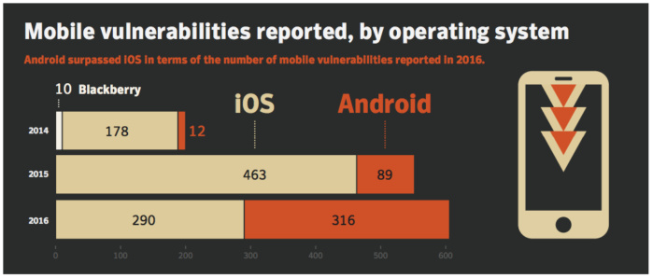
Android vs iOS security: Which is better?

Slide 52
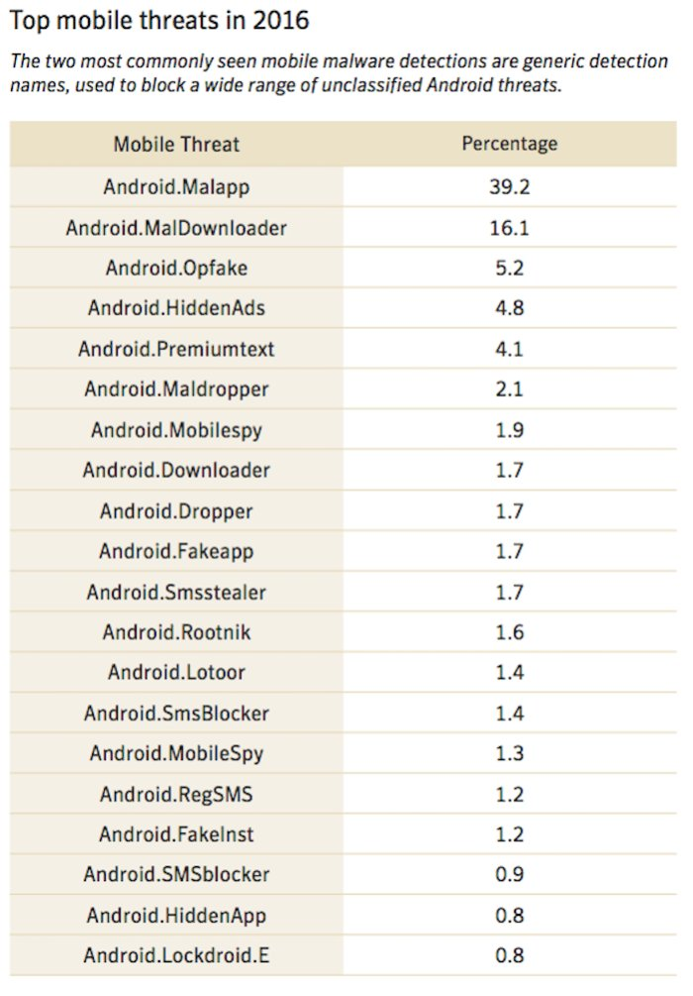
Android vs iOS security: Which is better?

Slide 53
Spring Security
Spring framework has two major applications which are authentication and authorization.
Authentication is a process of identifying and knowing the target user which wants to access the application.
Authorization is a process of allowing the authority to perform some actions in the application.
Apply authorization to a web request, methods and access to an individual domain.

Slide 54
Spring Security
Spring framework has two major applications which are authentication and authorization.
Authentication is a process of identifying and knowing the target user which wants to access the application.
Authorization is a process of allowing the authority to perform some actions in the application.
Apply authorization to a web request, methods and access to an individual domain.

Slide 55
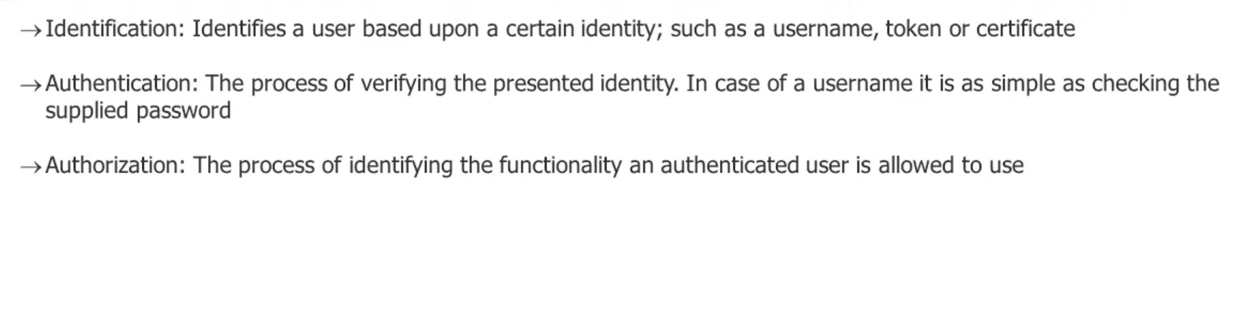
General Security Principles

Slide 56
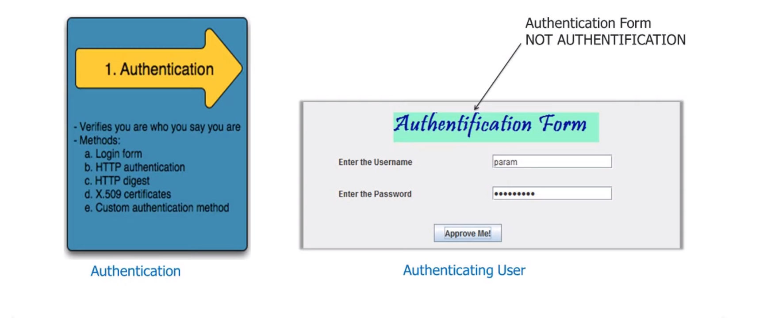
Authentication

Slide 57
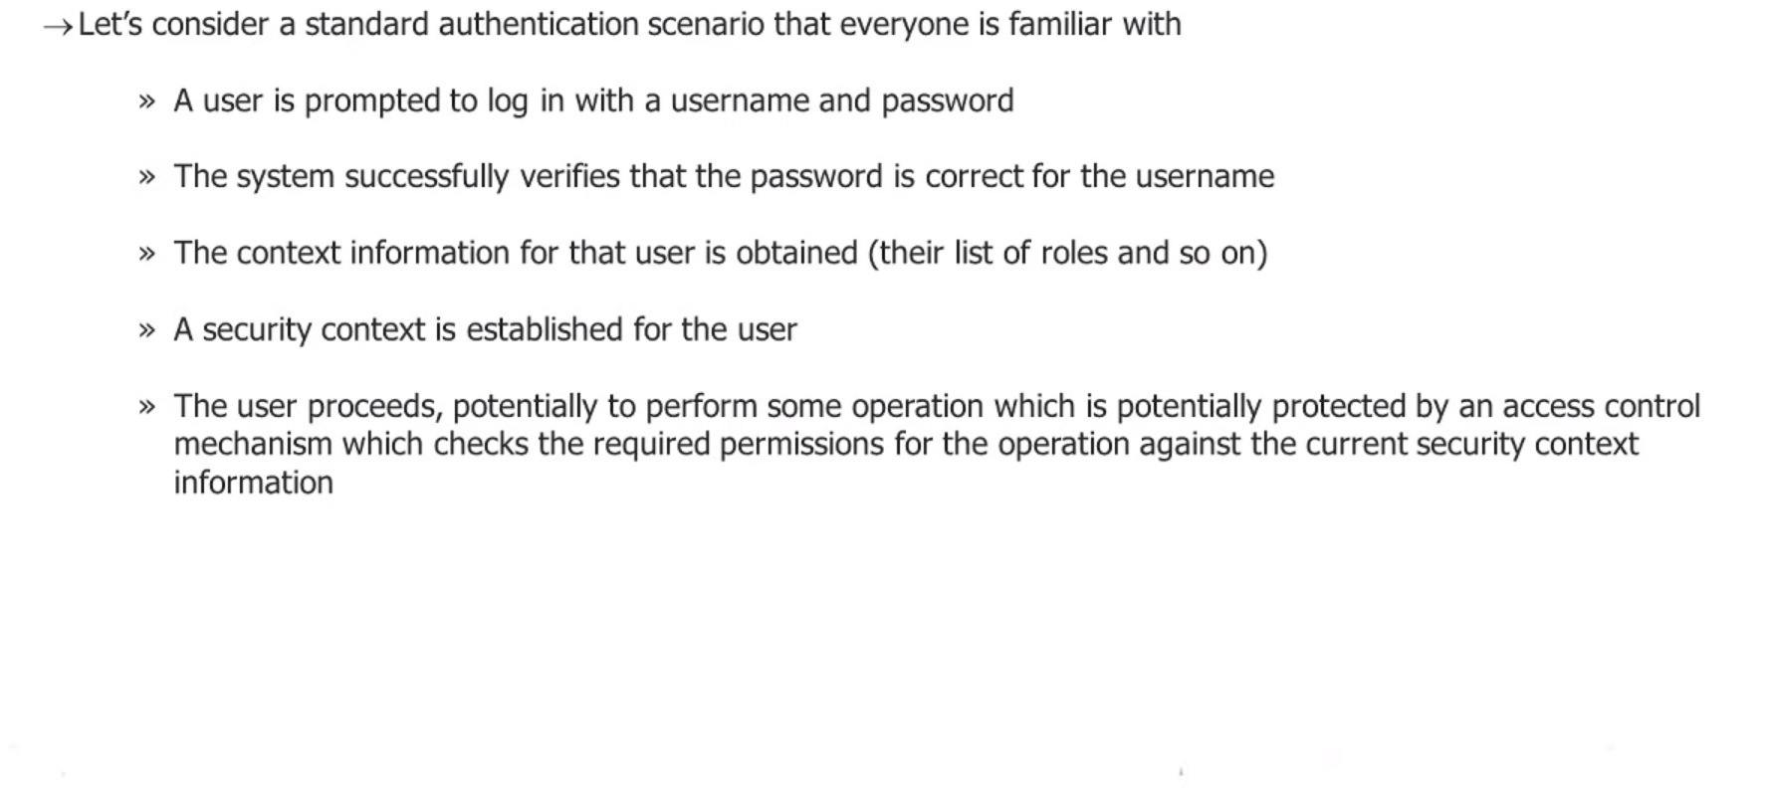
What is Authentication in Spring Security

Slide 58
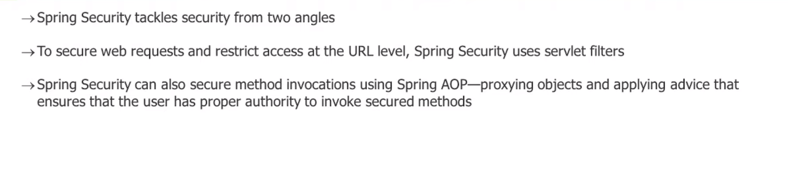
What is Authorization in Spring Security

Slide 59
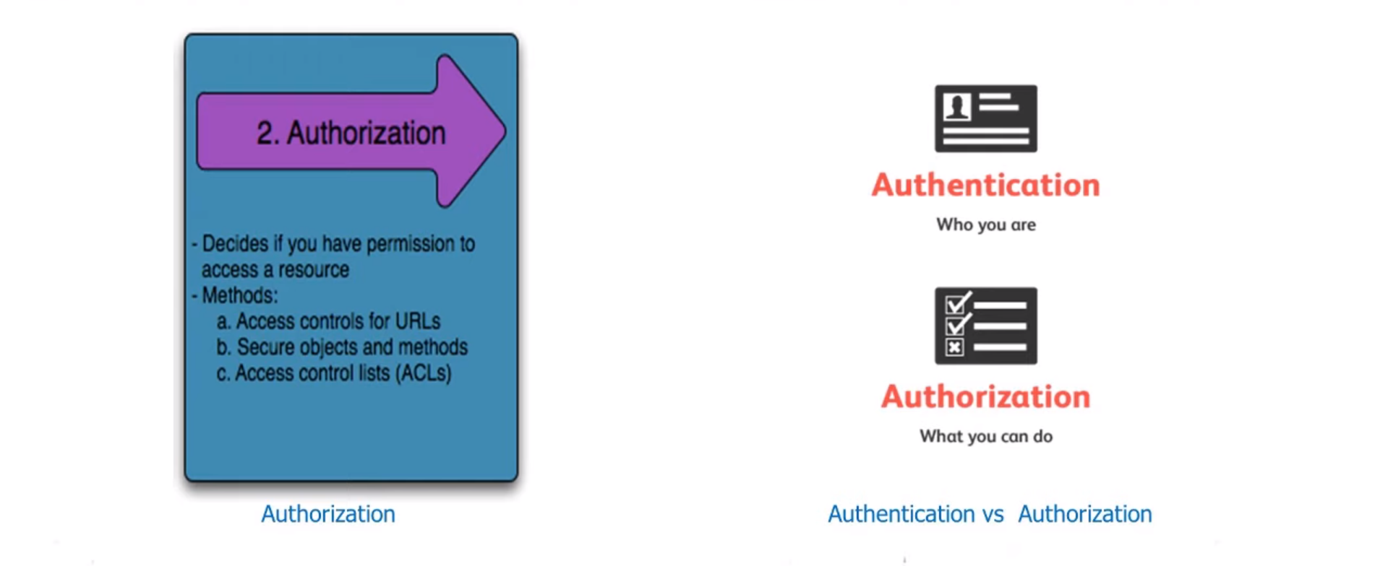
What is Authorization in Spring Security

Slide 60
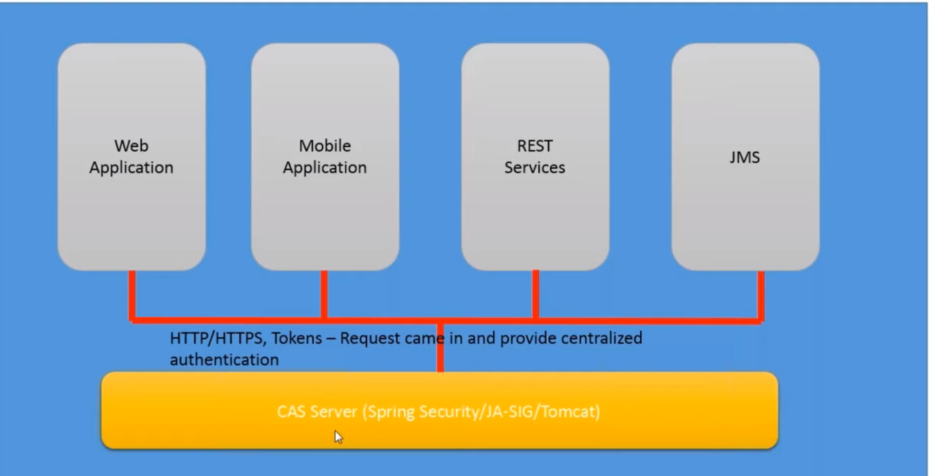
Spring Security Features

Slide 61
Spring Security Features
HTTP BASIC authentication headers
HTTP Digest authentication headers
HTTP X.509 client certificate exchange
LDAP (Lighweight Directory Access Protocol)
Form-based authentication
OpenID authentication
Automatic remember-me authentication
Kerberos
JOSSO (Java Open Source Single Sign-On)
AppFuse
AndroMDA
Mule ESB
DWR(Direct Web Request)

Slide 62
Spring Security Features
LDAP (Lightweight Directory Access Protocol)
Single sign-on
JAAS (Java Authentication and Authorization Service) LoginModule
Basic Access Authentication
Digest Access Authentication
Remember-me

Slide 63
Spring Security Features
Web Form Authentication
Authorization
Software Localization
HTTP Authorization

Slide 64
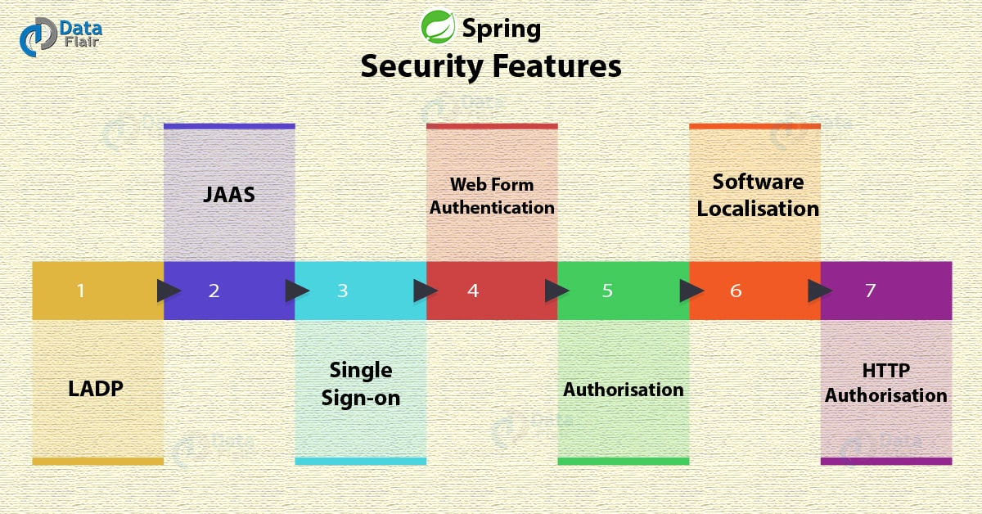
Spring Security Features

Slide 65
Spring Security Features
LDAP (Lightweight Directory Access Protocol)
It is an open application protocol for maintaining and accessing distributed directory information services over an Internet Protocol.
Single sign-on
This feature allows a user to access multiple applications with the help of single account(user name and password).
JAAS (Java Authentication and Authorization Service) LoginModule
It is a Pluggable Authentication Module implemented in Java. Spring Security supports it for its authentication process.

Slide 66
Spring Security Features
Basic Access Authentication
Spring Security supports Basic Access Authentication that is used to provide user name and password while making request over the network.
Digest Access Authentication
This feature allows us to make authentication process more secure than Basic Access Authentication. It asks to the browser to confirm the identity of the user before sending sensitive data over the network.
Remember-me
Spring Security supports this feature with the help of HTTP Cookies. It remember to the user and avoid login again from the same machine until the user logout.

Slide 67
Spring Security Features
Web Form Authentication
In this process, web form collect and authenticate user credentials from the web browser. Spring Security supports it while we want to implement web form authentication.
Authorization
Spring Security provides the this feature to authorize the user before accessing resources. It allows developers to define access policies against the resources.
Software Localization
This feature allows us to make application user interface in any language.

Slide 68
Spring Security Features
HTTP Authorization
Spring provides this feature for HTTP authorization of web request URLs using Apache Ant paths or regular expressions.

Slide 69
Features added in Spring Security 5.0
OAuth 2.0 Login
This feature provides the facility to the user to login into the application by using their existing account at GitHub or Google.
This feature is implemented by using the Authorization Code Grant that is specified in the OAuth 2.0 Authorization Framework.
Reactive Support
From version Spring Security 5.0, it provides reactive programming and reactive web runtime support and even, we can integrate with Spring WebFlux.

Slide 70
Features added in Spring Security 5.0
Modernized Password Encoding
Spring Security 5.0 introduced new Password encoder DelegatingPasswordEncoder which is more modernize and solve all the problems of previous encoder NoOpPasswordEncoder.

Slide 71
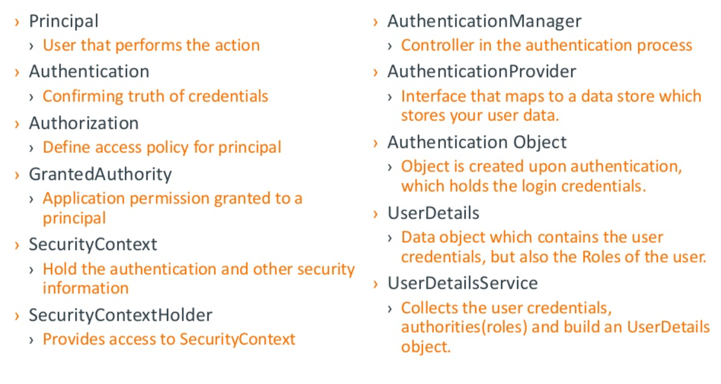
Spring Security Terms

Slide 72
Spring Project Modules
spring-security-core.jar
spring-security-remoting.jar
spring-security-web.jar
spring-security-config.jar
spring-security-ldap.jar
spring-security-oauth2-core.jar
spring-security-oauth2-client.jar
spring-security-oauth2-jose.jar
spring-security-acl.jar
spring-security-cas.jar
spring-security-openid.jar
spring-security-test.jar

Slide 73
Advantages of Spring Security
Configuration support to Java Programming Language.
Portable.
Comprehensive support to tasks like authorization and authentication.
Servlet API integration.
Spring MVC integration.
CSRF protection.
Protection against some common tasks.

Slide 74
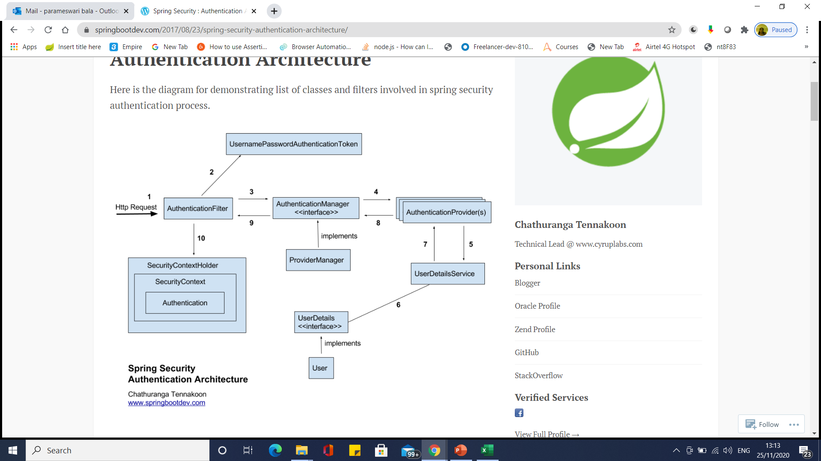
Spring Security Authentication Architecture

Slide 75
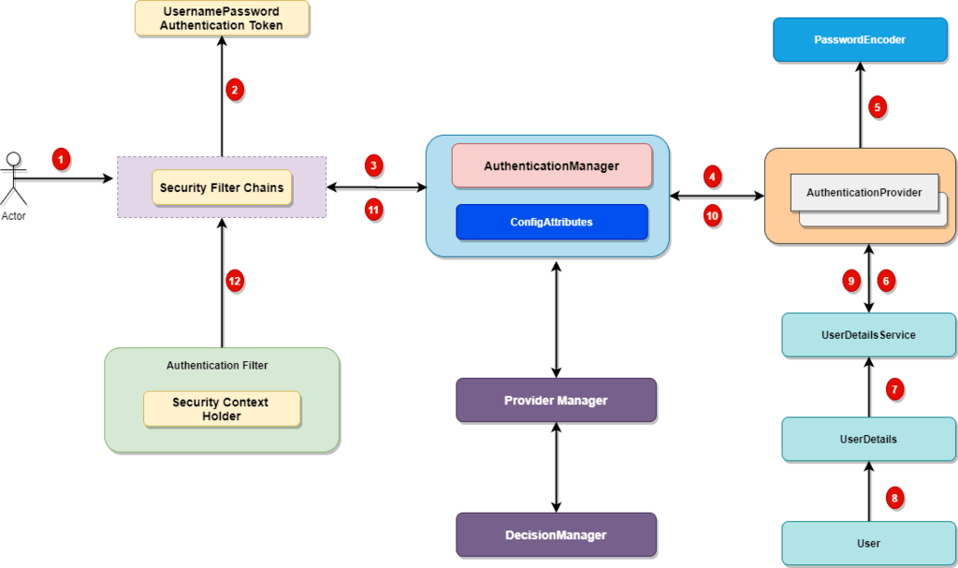
Spring Security Authentication Architecture

Slide 76
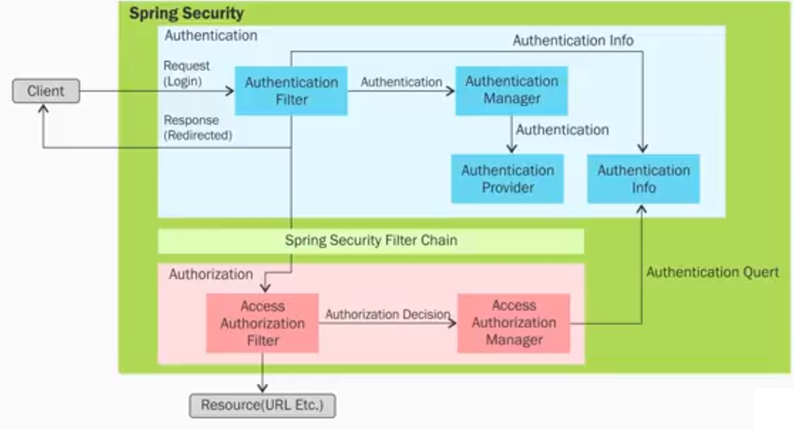
Spring Security Authentication Architecture

Slide 77
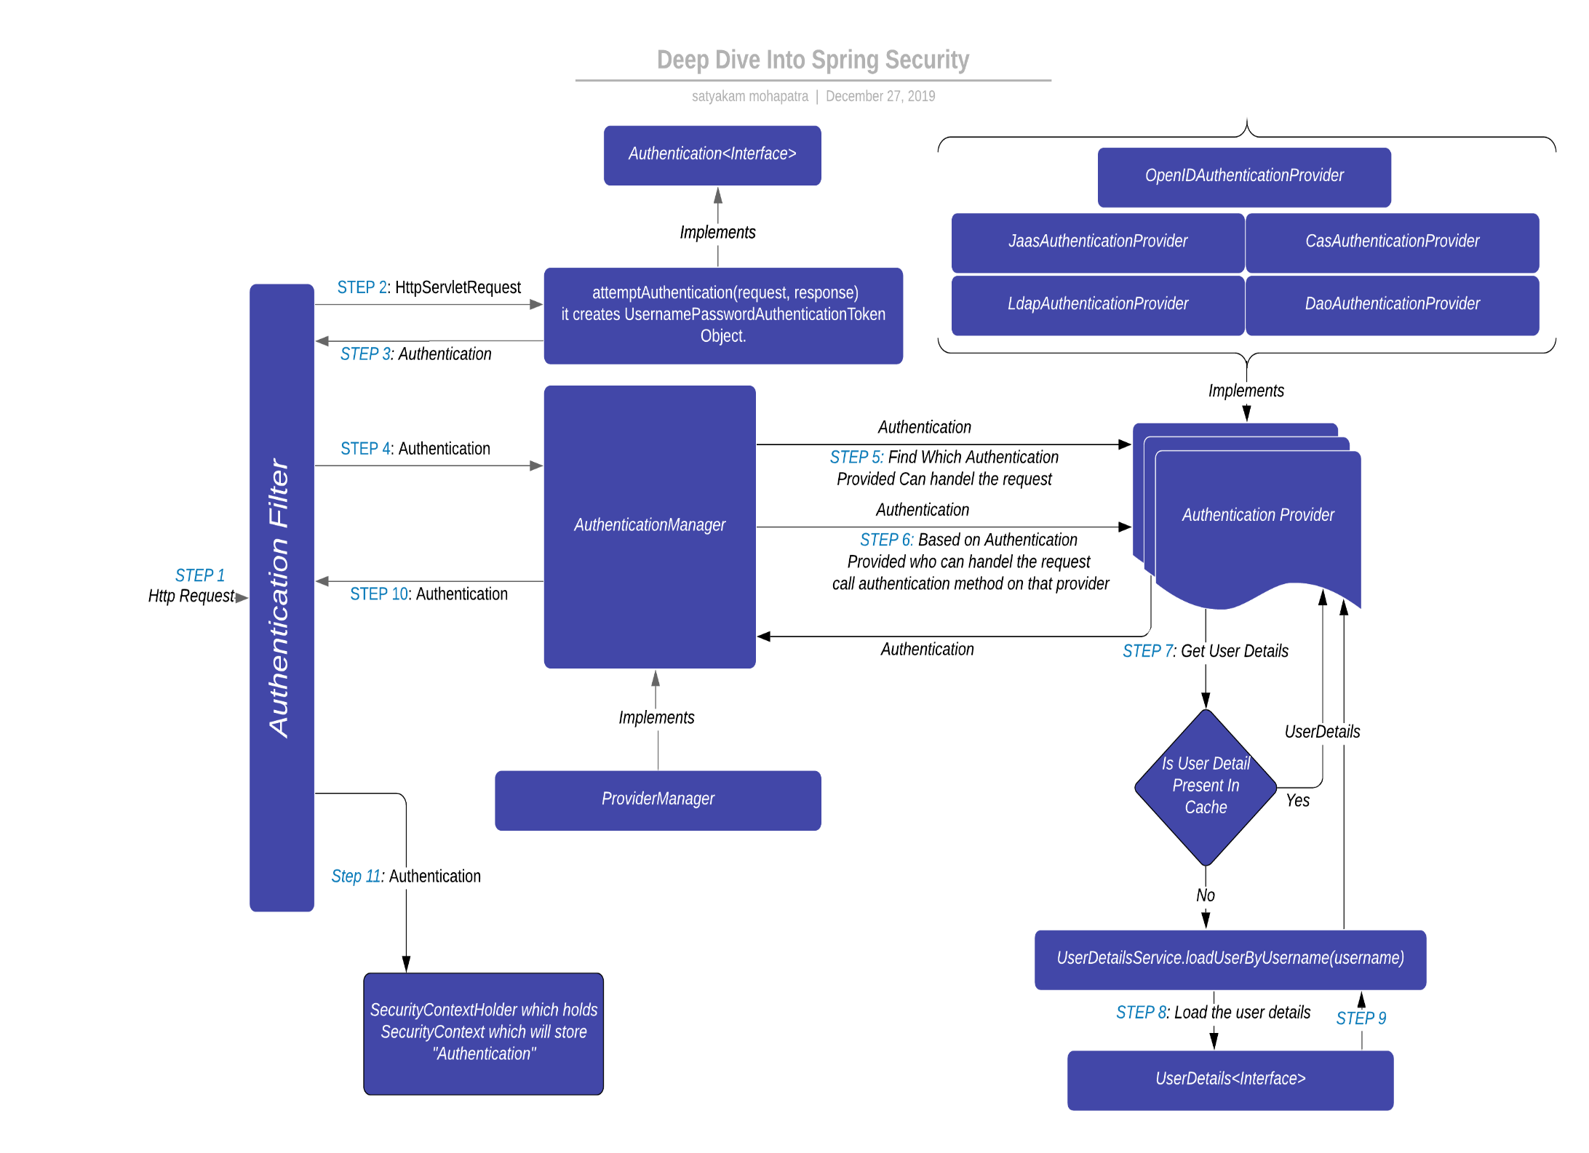

Slide 78
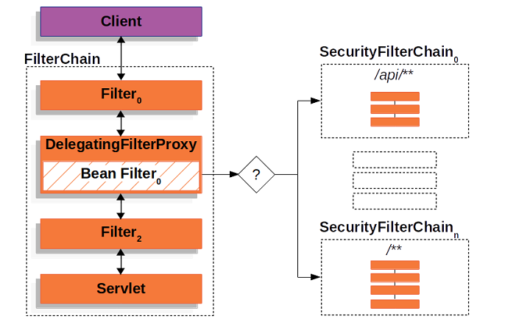
Security Filter Chain

Slide 79
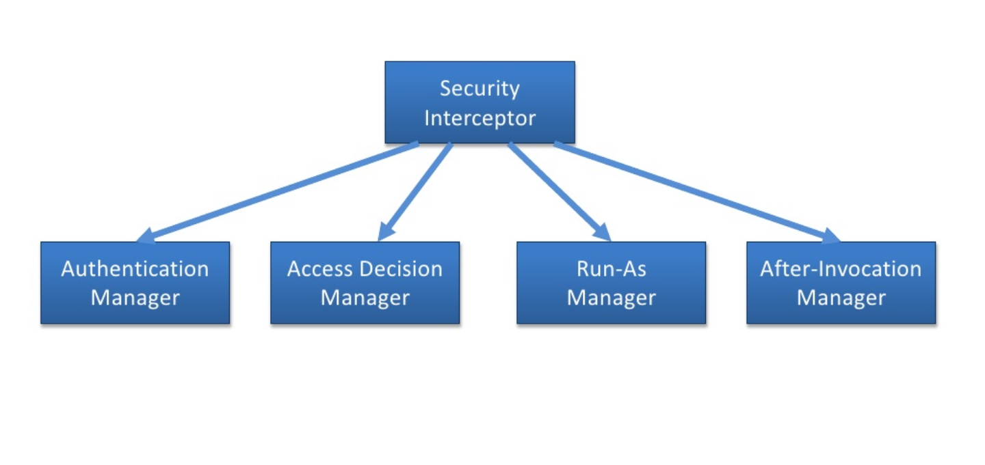
Spring Security Interceptors

Slide 80
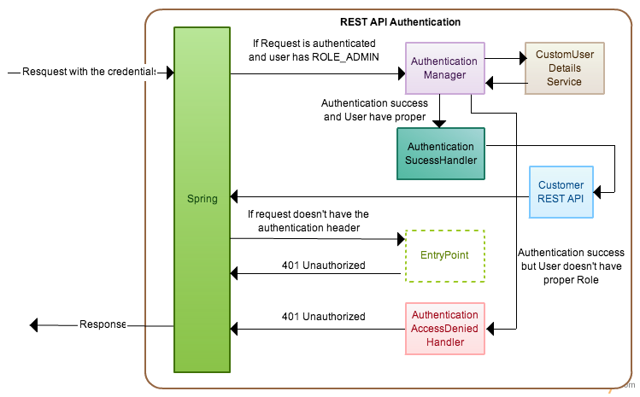
Spring Security

Slide 81
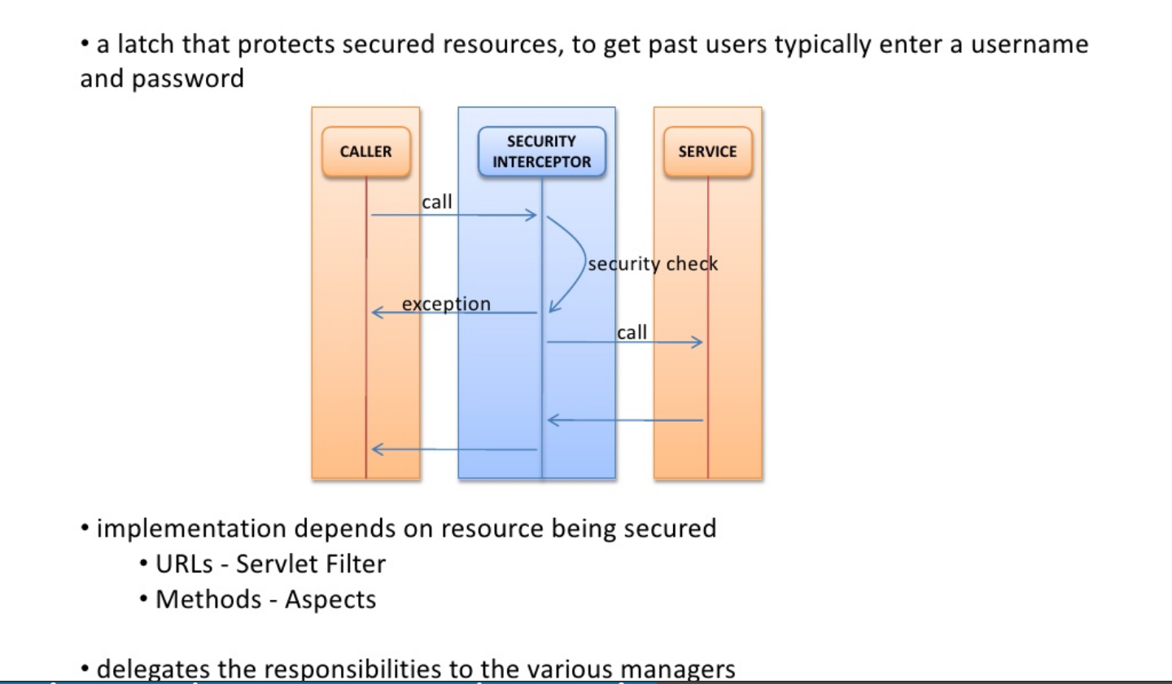
Spring Security Filters

Slide 82
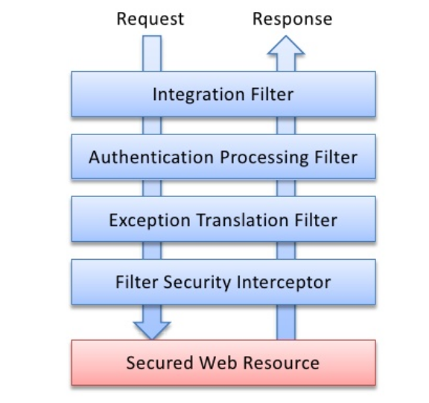
Spring Security Filters

Slide 83
Spring Security Filters
Filter | What it does
Integration fileter | responsible for retrieving a previously stored authentication (most likely stored in the HTTP session) so that it will be ready for Spring Security’s other filters to process.
Authentication Processing Filter | determine if the request is an authentication request. If so, the user information (typically a username / password pair) is retrieved from the request and passed on to the authentication manager.
Exception Translation Filter | translates exceptions, for AuthenticationException request will be sent to a login screen, for AccessDeniedException returns HTTP 403 to the browser.
Filter Security Interceptor | examine the request and determine whether the user has the necessary privileges to access the secured resource. It leans heavily on the authentication manager and the access decision manager.

Slide 84
Spring Security Filters
HttpRequestIntegrationFilter | populates the security context using information from the user principla.
CaptchaValidationProcessingFilter | helps to identify a user as a human using Captcha techniques.
ConcurrentSessionFilter | ensures that a user is not simultaneously logged in more than a set number of times.
HttpSessionContextIntegrationFilter | populates the security context using information obtained from the http session.
FilterSecurityInterceptor | Decides whether or not to allow access to a secured resource.
AnonymousProcessingFilter | Used to identify an unauthenticated user as an anonymous user.
ChannelProcessingFilter | Ensures that a request is being sent over HTTP or HTTPS.

Slide 85
Spring Security Filters
BasicProcessingFilter | Attempts to authenticate a user by processing an HTTP basic authentication.
CasProcessingFilter | Authenticates a user by processing a CAS (Central Authentication Service) ticket.
DigestProcessingFilter | Attempts to authenticate a user by processing an HTTP Digest authentication.
ExceptionTranslationFilter | Handles any AccessDeniedException or AuthenticationException.
LogoutFilter | Used to log a user out of the application.
RememberMeProcessingFilter | Automatically authenticates a user who has asked to be “remembered” by the application.
SwitchUserProcessingFilter | Used to switch out a user. Provides functionality similar to Unix’s su.

Slide 86
Spring Security Filters
AuthenticationProcessingFilter | Accepts the user’s principal and credentials and attempts to authenticate the user.
SiteminderAuthenticationProcessingFilter | Authenticates a user by processing CA/Netegrity SiteMinder headers.
X509ProcessingFilter | Authenticates a user by processing an X.509 certificate submitted by a client web browser.
SecurityContextHolderAwareRequestFilter | populates the servlet request with a request wrapper.

Slide 87
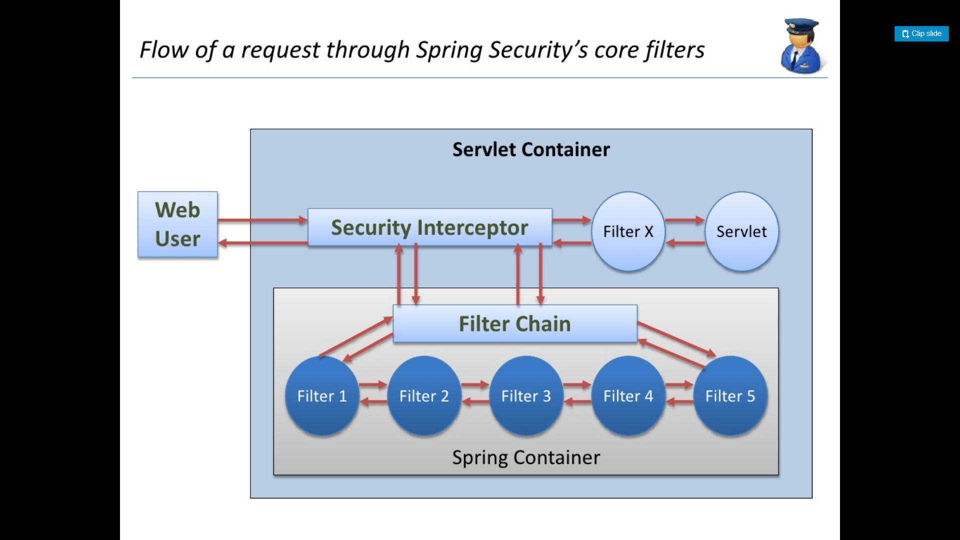

Slide 88
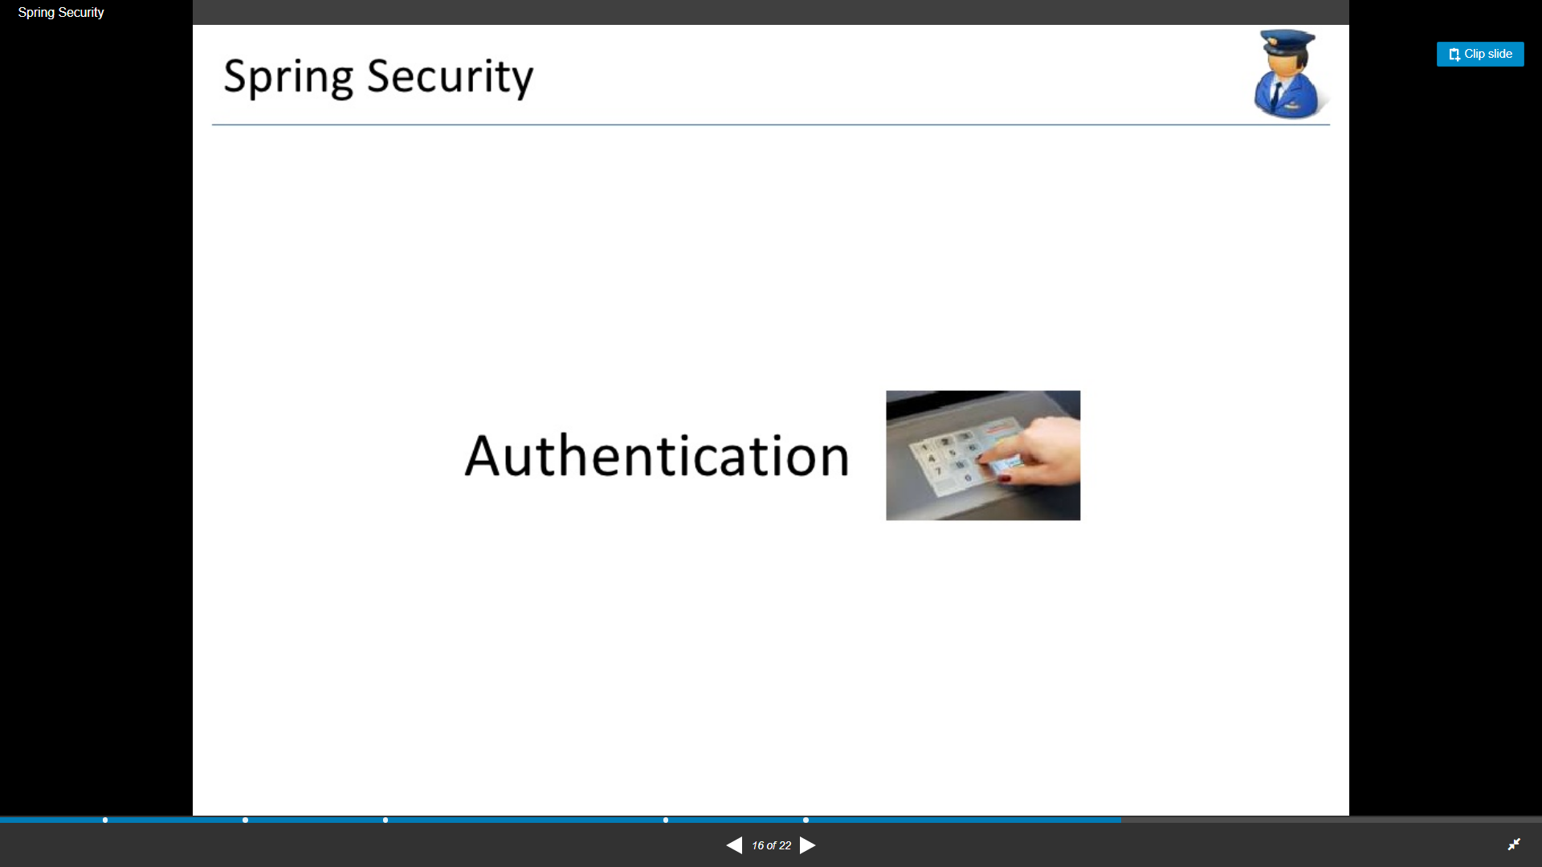

Slide 89
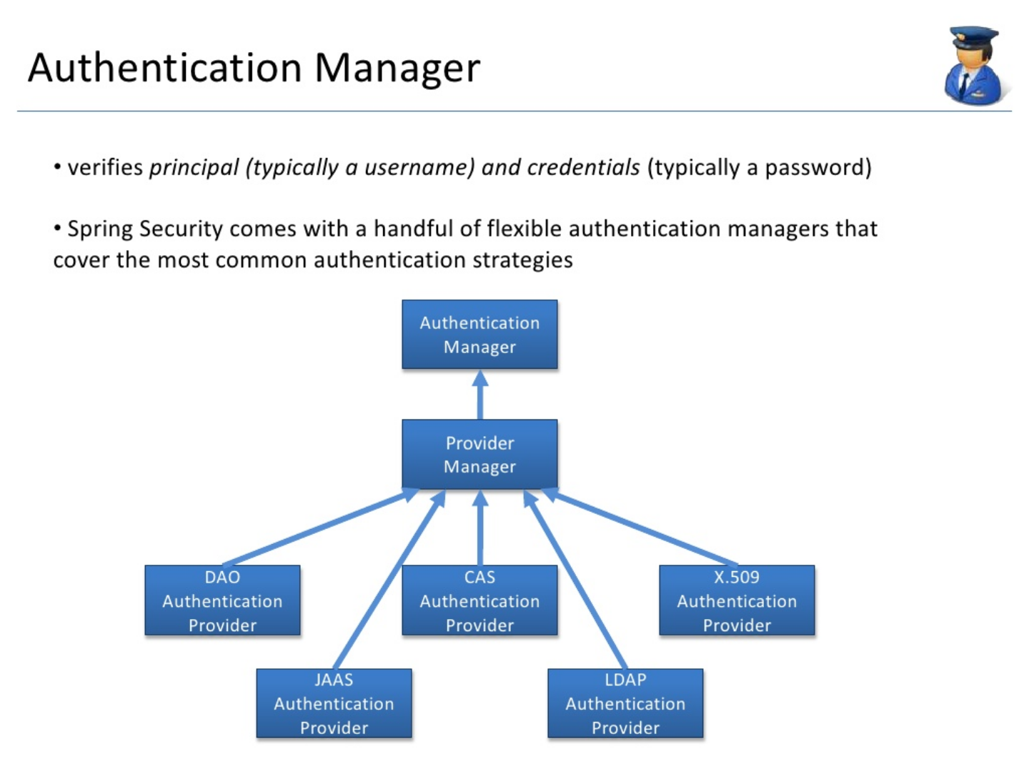

Slide 90
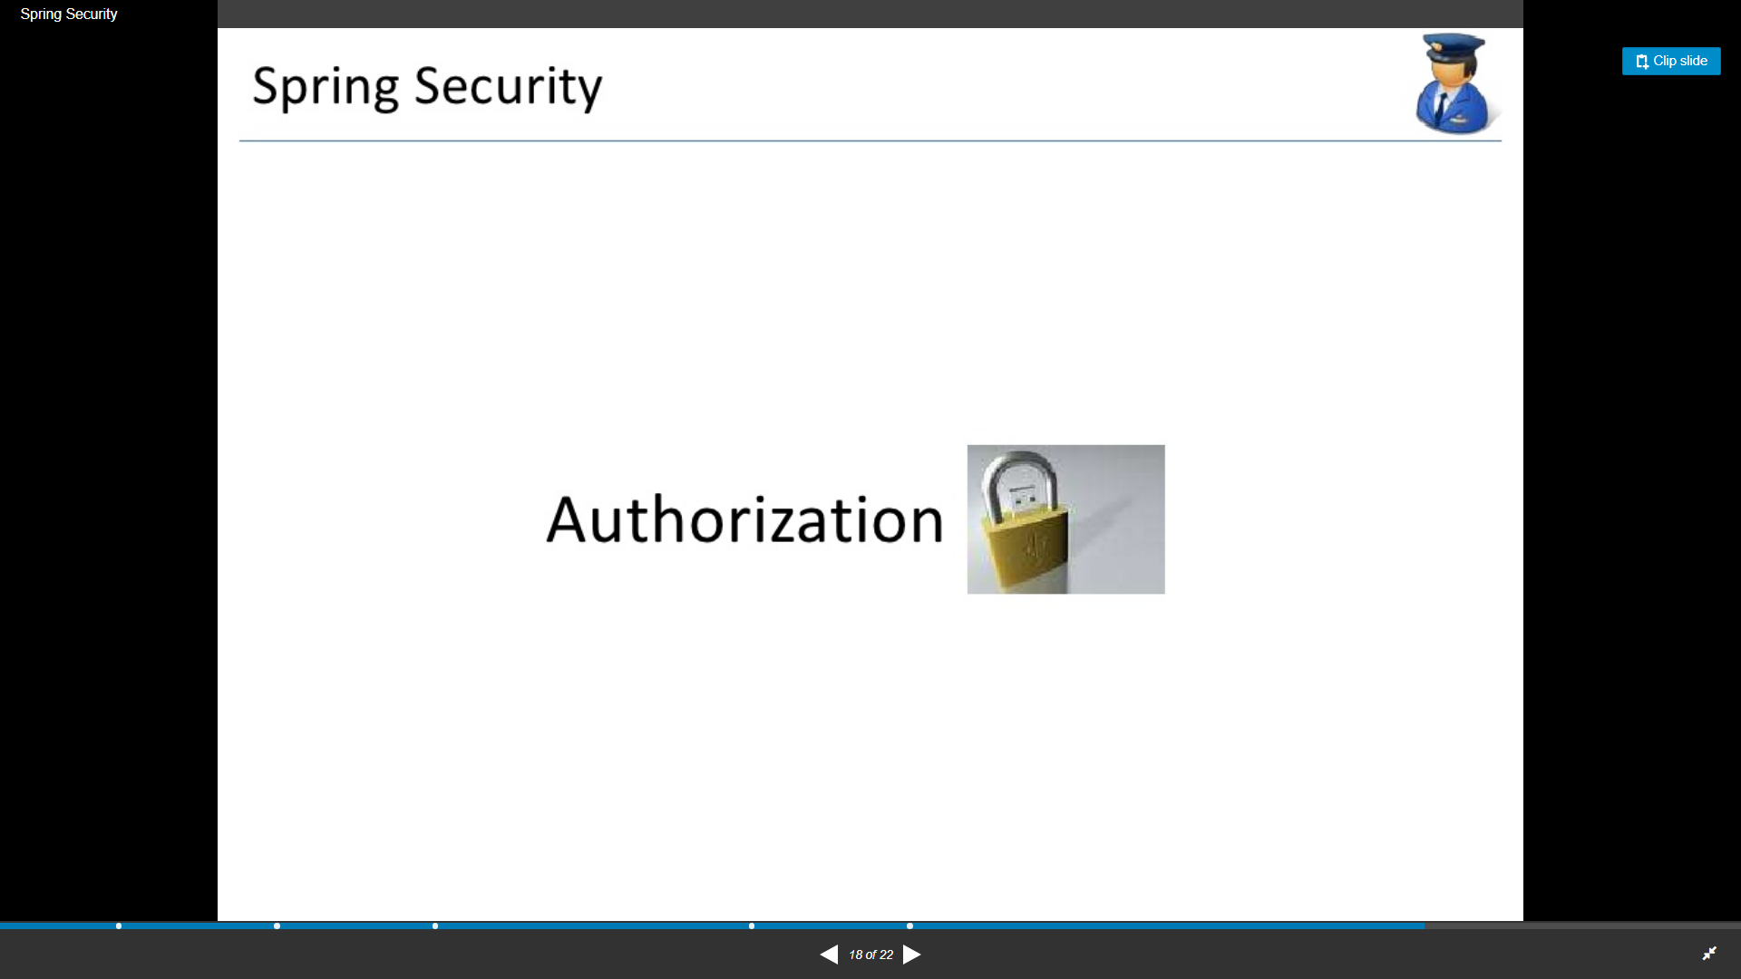

Slide 91
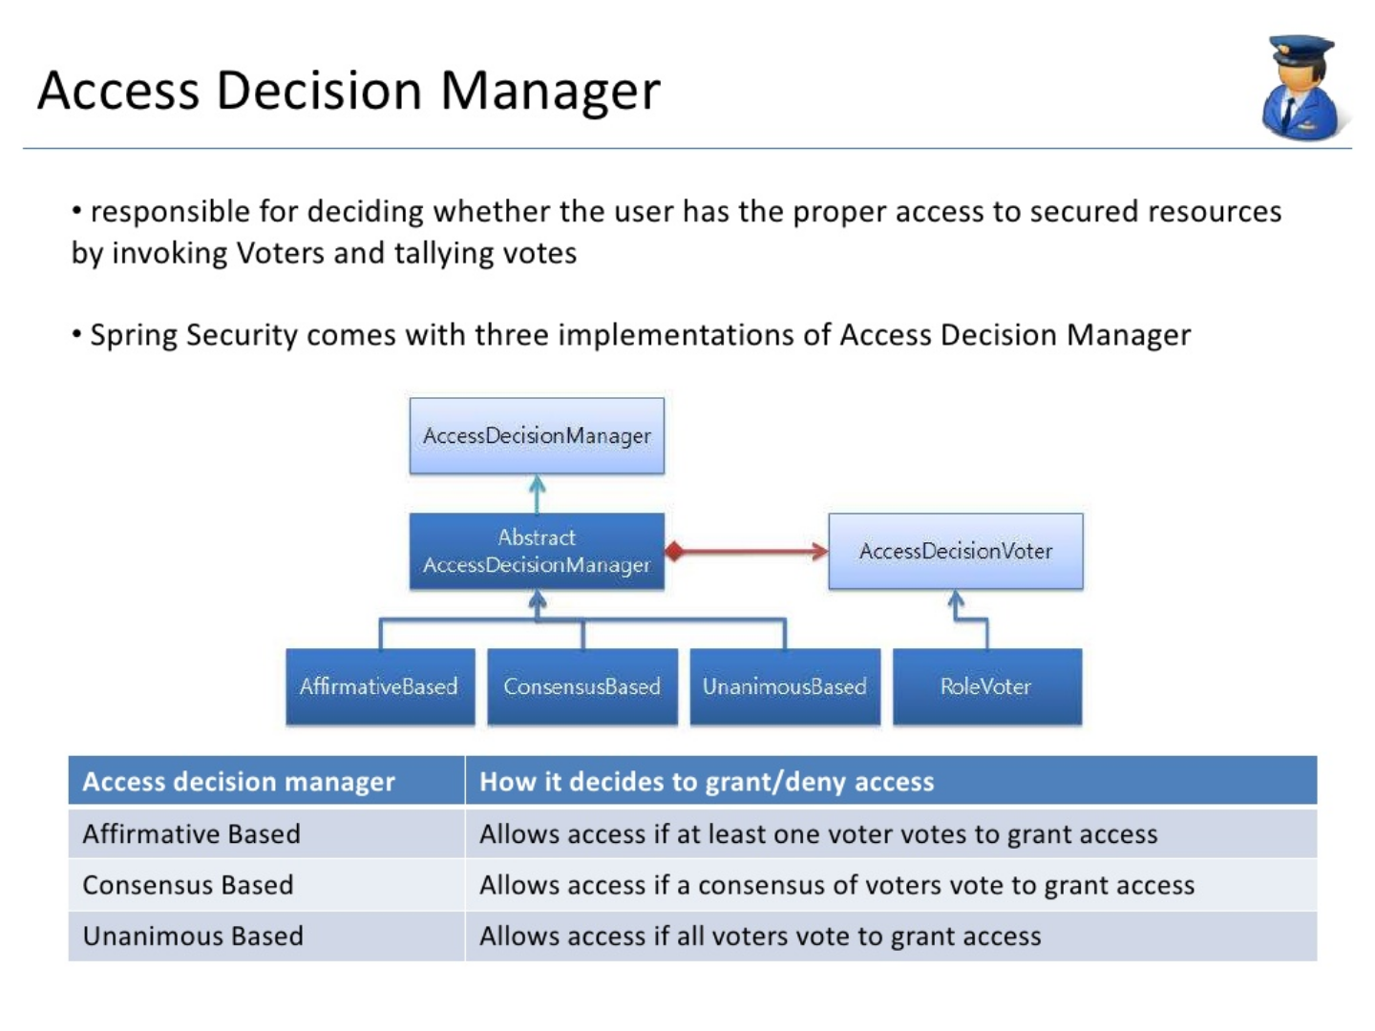

Slide 92
Creating a Keystore File and Keystore Password for HTTPS Connections
% keytool -genkey -alias tomcat -keyalg RSA -keystore /keystore-location -storepass password
keytool -genkey -noprompt -alias <your-alias> -keyalg RSA -keystore <your-file-name> -keypass <your-password>
-storepass <your-password> -dname "CN=<your-cert-name>, OU=<your-organization-unit>, O=<your-organization>,
L=<your-location>, ST=<state>, C=<two-letter-country-code>"

Slide 93
Creating a Keystore File and Keystore Password for HTTPS Connections
keytool -genkey -noprompt -alias tomcat-localhost -keyalg RSA -keystore localhost-rsa.jks -keypass test@123 -storepass test@123 -dname "CN=tomcat-cert, OU=Dev, O=Virtusa, L=Chennai, ST=TN, C=IN"
Enhance the certificate
keytool -importkeystore -srckeystore localhost-rsa.jks -destkeystore banking-rsa.jks -deststoretype pkcs12 -noprompt -alias tomcat-localhost -keyalg RSA -keypass test@123 -storepass test@123 -dname "CN=tomcat-cert, OU=Dev, O=Virtusa, L=Chennai, ST=TN, C=IN"

Slide 94
How to Obtain a Signature for an SSL Certificate
Generate
keytool -certreq -v -alias tomcat -keyalg RSA -keystore /keystore-location
keytool -certreq -v -alias tomcat-localhost -keyalg RSA -keystore banking-rsa.jks
Print certificate
% keytool -printcert -file certificate-reply-file
keytool -v -import -trustcacerts -keystore /keystore-location -file certificate-reply-file -alias tomcat
keytool -v -list -keystore /keystore-location

Slide 95
How to configure Maven Tomcat Plugin to use HTTPS (SSL/TLS)
(1)Creating a Keystore
(2)Configuring tomcat7-maven-plugin to use HTTPS
<plugin>
<groupId>org.apache.tomcat.maven</groupId>
<artifactId>tomcat7-maven-plugin</artifactId>
<version>2.2</version>
<configuration>
<path>/</path>
<httpsPort>8443</httpsPort>
<keystoreFile>C:\my-cert-dir\localhost-rsa.jks</keystoreFile>
<keystorePass>123456</keystorePass>
</configuration>
</plugin>

Slide 96
User credentials are sent in clear / easy to decode format
Password Hashing
Hash algorithms are one way functions. They turn any amount of data into a fixed-length "fingerprint" that cannot be reversed.
They also have the property that if the input changes by even a tiny bit, the resulting hash is completely different.
This is great for protecting passwords, because we want to store passwords in a form that protects them even if the password file itself is compromised.
But at the same time, we need to be able to verify that a user's password is correct.

Slide 97
User credentials are sent in clear / easy to decode format
The general workflow for account registration and authentication in a hash-based account system is as follows:
The user creates an account.
Their password is hashed and stored in the database. At no point is the plain-text (unencrypted) password ever written to the hard drive.
When the user attempts to login, the hash of the password they entered is checked against the hash of their real password (retrieved from the database).
If the hashes match, the user is granted access. If not, the user is told they entered invalid login credentials.
Steps 3 and 4 repeat every time someone tries to login to their account.
In step 4, never tell the user if it was the username or password they got wrong. Always display a generic message like "Invalid username or password." This prevents attackers from enumerating valid usernames without knowing their passwords.

Slide 98
User credentials are sent in clear / easy to decode format
The hash functions used to implement data structures such as hash tables are designed to be fast, not secure.
Only cryptographic hash functions may be used to implement password hashing.
Hash functions like SHA256, SHA512, RipeMD, and WHIRLPOOL are cryptographic hash functions.

Slide 99
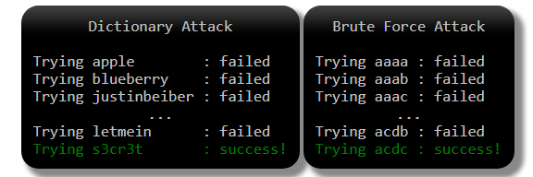
User credentials are sent in clear / easy to decode format
How Hashes are Cracked
Dictionary and Brute Force Attacks

Slide 100
User credentials are sent in clear / easy to decode format
How Hashes are Cracked
Lookup Tables
Lookup tables are an extremely effective method for cracking many hashes of the same type very quickly.
The general idea is to pre-compute the hashes of the passwords in a password dictionary and store them, and their corresponding password, in a lookup table data structure.
A good implementation of a lookup table can process hundreds of hash lookups per second, even when they contain many billions of hashes.

Slide 101
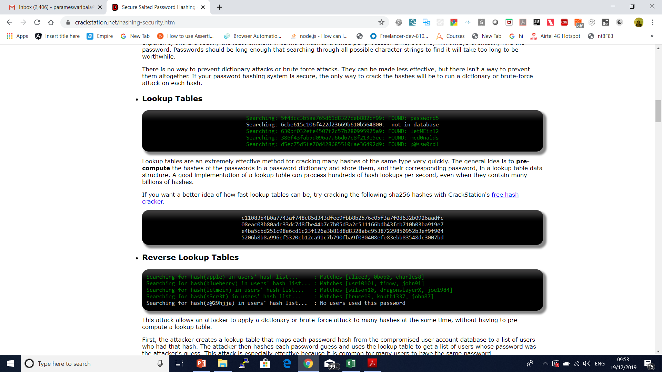
User credentials are sent in clear / easy to decode format
How Hashes are Cracked
Lookup Tables

Slide 102
User credentials are sent in clear / easy to decode format
How Hashes are Cracked
The WRONG Way: Short Salt & Salt Reuse
Salt Reuse
A common mistake is to use the same salt in each hash.
Either the salt is hard-coded into the program, or is generated randomly once.
This is ineffective because if two users have the same password, they'll still have the same hash.
An attacker can still use a reverse lookup table attack to run a dictionary attack on every hash at the same time.
They just have to apply the salt to each password guess before they hash it.
If the salt is hard-coded into a popular product, lookup tables and rainbow tables can be built for that salt, to make it easier to crack hashes generated by the product.

Slide 103
User credentials are sent in clear / easy to decode format
Short Salt
If the salt is too short, an attacker can build a lookup table for every possible salt. For example, if the salt is only three ASCII characters, there are only 95x95x95 = 857,375 possible salts.
That may seem like a lot, but if each lookup table contains only 1MB of the most common passwords, collectively they will be only 837GB, which is not a lot considering 1000GB hard drives can be bought for under $100 today.
For the same reason, the username shouldn't be used as a salt.
Usernames may be unique to a single service, but they are predictable and often reused for accounts on other services.
An attacker can build lookup tables for common usernames and use them to crack username-salted hashes.
To make it impossible for an attacker to create a lookup table for every possible salt, the salt must be long.
A good rule of thumb is to use a salt that is the same size as the output of the hash function. For example, the output of SHA256 is 256 bits (32 bytes), so the salt should be at least 32 random bytes.

Slide 104
User credentials are sent in clear / easy to decode format
The WRONG Way: Double Hashing & Wacky Hash Functions
Here are some examples of poor wacky hash functions I've seen suggested in forums on the internet.
md5(sha1(password))
md5(md5(salt) + md5(password))
sha1(sha1(password))
sha1(str_rot13(password + salt))
md5(sha1(md5(md5(password) + sha1(password)) + md5(password)))
Do not use any of these.

Slide 105
User credentials are sent in clear / easy to decode format
The RIGHT Way: How to Hash Properly
Salt should be generated using a Cryptographically Secure Pseudo-Random Number Generator (CSPRNG).
CSPRNGs are very different than ordinary pseudo-random number generators, like the "C" language's rand() function.
As the name suggests, CSPRNGs are designed to be cryptographically secure, meaning they provide a high level of randomness and are completely unpredictable.
We don't want our salts to be predictable, so we must use a CSPRNG.

Slide 106
User credentials are sent in clear / easy to decode format
java.lang.Object
extended by java.util.Random
extended by java.security.SecureRandom
SecureRandom random = new SecureRandom();
byte bytes[] = new byte[20];
random.nextBytes(bytes);

Slide 107
User credentials are sent in clear / easy to decode format
To Store a Password
Generate a long random salt using a CSPRNG.
Prepend the salt to the password and hash it with a standard password hashing function like Argon2, bcrypt, scrypt, or PBKDF2.
Save both the salt and the hash in the user's database record.
To Validate a Password
Retrieve the user's salt and hash from the database.
Prepend the salt to the given password and hash it using the same hash function.
Compare the hash of the given password with the hash from the database. If they match, the password is correct. Otherwise, the password is incorrect.

Slide 108
User credentials are sent in clear / easy to decode format
Making Password Cracking Harder: Slow Hash Functions
Use a standard algorithm like PBKDF2 or bcrypt.

Slide 109
User credentials are sent in clear / easy to decode format
Hashing Passwords in Java with Bcrypt.
BCrypt is a one way salted hash function based on the Blowfish cipher.
It provides several enhancements over plain text passwords.

Slide 110
User credentials are sent in clear / easy to decode format
BCrypt features
Not plain text - Not only do plain text passwords compromise your website if the database is breached but they can also compromise other websites for the users. Unfortunately a lot of users share passwords across websites.
One way hashing - BCrypt is a one way hash function to obfuscate the password such that it is not stored in plain text.
Salted hashing - Generating random bytes (the salt) and combining it with the password before hashing creates unique hashes across each users password. If two users have the same password they will not have the same password hash. This is to prevent rainbow table attacks which can reverse hashed passwords using common hashing functions that do not utilize a salt.
Logarithmic iterations - The hashing function is executed many times sequentially which can be increased exponentially known as key stretching. This is to make the function CPU intensive which makes it more secure against brute force attacks.
Updatable iterations - As CPUs become faster so do brute force attacks. Since BCrypt stores the number of iterations as part of the hash it's possible to verify a password and then increase its strength by generating a new hash with a higher number of iterations.

Slide 111
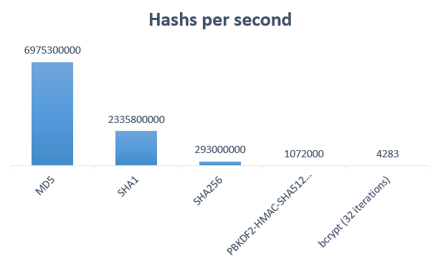

Slide 112
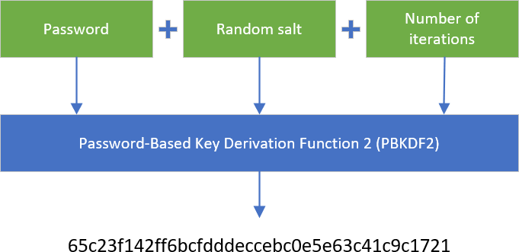

Slide 113
Common Security Vulnerabilities
Broken authentication
Session fixation
Cross-site scripting (XSS)
Cross-site request forgery (CSRF)
Injections
Sensitive data exposure
Lack of method access control
Using dependencies with known vulnerabilities

Slide 114
Host Header Attack
The “HOST” header is part of the http protocol, vulnerable applications are vulnerable because they insert the value of this header into the application code without proper validation.
It means not only applications hosted on Apache/Nginx can be vulnerable.
For Host Header Attack Exploitation, basically there are two ways through which you can exploit the application i.e.
By means of Web Cache Poisoning which manipulates caching systems into storing a page generated with a malicious host .
other is via Password Reset Emails when poisoned content is delivered directly to the target.

Slide 115
Why HTTP host header needed ?
According to RFC 2616: A client MUST include a Host header field in all HTTP/1.1 request messages.
If the requested URI does not include an Internet host name for the service being requested, then the Host header field MUST be given with an empty value.
Any HTTP/1.1 request without host header field must be responded by server with 400(bad request) status code.

Slide 116
Why HTTP host header needed ?
There are several different types of attacks related to host header injection
Unauthorized URL Redirect by Cache poisoning
Password Reset Poisoning
Access to internal hosts
Cross site scripting

Slide 117
Why HTTP host header needed ?
There are several different types of attacks related to host header injection
Unauthorized URL Redirect by Cache poisoning
Password Reset Poisoning
Access to internal hosts
Cross site scripting

Slide 118
Prevent Host Header Attack
<a href="<?=$_SERVER['HTTP_HOST']?>/blog/">Blog</a>

Slide 119
HTML Injection
The essence of this type of injection attack is injecting HTML code through the vulnerable parts of the website.
The Malicious user sends HTML code through any vulnerable field with a purpose to change the website’s design or any information, that is displayed to the user.
In the result, the user may see the data, that was sent by the malicious user.
Therefore, in general, HTML Injection is just the injection of markup language code to the document of the page.
Data, that is being sent during this type of injection attack may be very different.
It can be a few HTML tags, that will just display the sent information. Also, it can be the whole fake form or page.
When this attack occurs, the browser usually interprets malicious user data as legit and displays it.

Slide 120
Types of HTML Injection
Firstly, different types may be sorted by the risks, that they bring.
As mentioned, this injection attack can be performed with two different purposes:
To change the displayed website’s appearance.
To steal another person’s identity.
However, the main types are:
Stored HTML Injection
Reflected HTML Injection

Slide 121
Stored HTML Injection:
Stored injection attack occurs when malicious HTML code is saved in the web server and is being executed every time when the user calls an appropriate functionality.

Slide 122
Reflected HTML Injection:
This can be again divided into more types:
Reflected GET
Reflected POST
Reflected URL

Slide 123
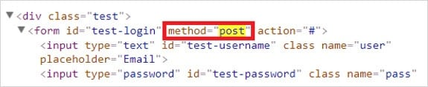
For Example, a tester can check the source code for the login form and find what method is being used for it. Then appropriate HTML Injection method can be selected accor

Slide 124
Reflected HTML Injection:
Reflected GET Injection occurs, when our input is being displayed (reflected) on the website.
Suppose, we have a simple page with a search form, which is vulnerable to this attack.
Then if we would type any HTML code, it will appear on our website and at the same time, it will be injected into the HTML document.

Slide 125
How to Prevent HTML Injection?
There are no doubts, that the main reason for this attack is the developer's inattention and lack of knowledge.
This type of injection attack occurs when the input and output are not properly validated.
Therefore the main rule to prevent HTML attack is appropriate data validation.

Slide 126
Authentication Bypass
Applications require authentication for gaining access to private information.
Not every authentication method is able to provide adequate security.
A flaw in the application that allows users to access application resources without authentication is referred as’ Authentication Bypass’.
Authentication bypass vulnerability is generally caused when it is assumed that users will behave in a certain way and failing to foresee the consequences of users doing the unexpected.

Slide 127
Methods to bypass the authentication schema:
There are several methods to bypass the authentication schema in use by a web application. Here are some of the common ways to bypass authentication:
Direct page request (Forced Browsing)
Parameter Modification
Session ID Prediction
SQL Injection

Slide 128
Test Authorization Bypass
Testing for access to administrative functions
For example, suppose that the 'AddUser.jsp' function is part of the administrative menu of the application, and it is possible to access it by requesting the following URL:
https://www.example.com/admin/addUser.jsp

Slide 129
Test Authorization Bypass
Then, the following HTTP request is generated when calling the AddUser function:
POST /admin/addUser.jsp HTTP/1.1
Host: www.example.com
[other HTTP headers]
userID=fakeuser&role=3&group=grp001
What happens if a non-administrative user tries to execute that request? Will the user be created? If so, can the new user use their privileges?

Slide 130
Session Hijacking
TCP session hijacking is a security attack on a user session over a protected network.
The most common method of session hijacking is called IP spoofing, when an attacker uses source-routed IP packets to insert commands into an active communication between two nodes on a network and disguising itself as one of the authenticated users.
This type of attack is possible because authentication typically is only done at the start of a TCP session.

Slide 131
Session Hijacking
Another type of session hijacking is known as a man-in-the-middle attack, where the attacker, using a sniffer, can observe the communication between devices and collect the data that is transmitted.

Slide 132
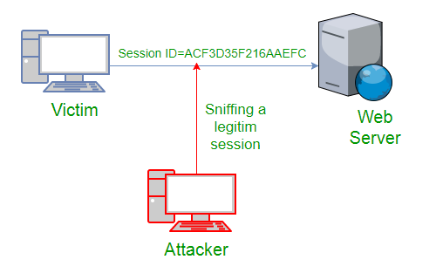
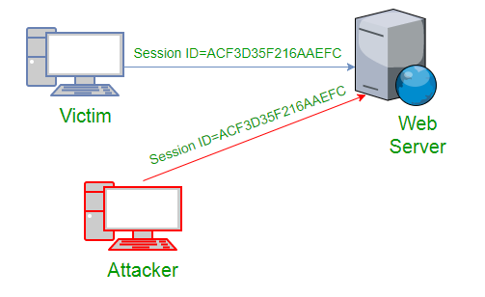

Slide 133
Session Hijacking
Cross Site Scripting(XSS Attack)
Attacker can also capture victim’s Session ID using XSS attack by using javascript.
If an attacker sends a crafted link to the victim with the malicious JavaScript, when the victim clicks on the link, the JavaScript will run and complete the instructions made by the attacker.

Slide 134
Session Hijacking
IP Spoofing
Spoofing is pretending to be someone else.
This is a technique used to gain unauthorized access to the computer with an IP address of a trusted host.
In implementing this technique, attcker has to obtain the IP address of the client and inject his own packets spoofed with the IP address of client into the TCP session, so as to fool the server that it is communicating with the victim i.e. the original host.

Slide 135
Session Hijacking
Blind Attack
If attacker is not able to sniff packets and guess the correct sequence number expected by server, brute force combinations of sequence number can be tried.

Slide 136
Mitigation
To defend a network with session hijacking, a defender has to implement both security measures at Application level and Network level.
Network level hijacks can be prevented by Ciphering the packets so that the hijacker cannot decipher the packet headers, to obtain any information which will aid in spoofing.
This encryption can be provided by using protocols such as IPSEC, SSL, SSH etc.
Internet security protocol (IPSEC) has the ability to encrypt the packet on some shared key between the two parties involved in communication. IPsec runs in two modes: Transport and Tunnel.
In Transport Mode only the data sent in the packet is encrypted while in Tunnel Mode both packet headers and data are encrypted, so it is more restrictive.

Slide 137
Iframe Injection
A Frame Injection is a type of Code Injection vulnerability classified by OWASP Top 10 2017 in its A1 Injection category.
Cross-site Scripting is naturally prioritized by bug bounty hunters since it seems easily exploitable and effective.
But malicious hackers are also attracted to this vulnerability, because there are aspects of the Frame Injection attack that can allow hackers to redirect users to other malicious websites used for phishing and similar attacks.

Slide 138
Iframe Injection
1. First of all attacker will find the Vulnerable websites using google dorks.
2. They test the vulnerability by inserting some iframe tag using the url.
3. then insert the Malicious Iframe code inside the webpage.
For Example:
he can insert this code using the url:
<iframe src=”http://malwarewebpages/web.html” width=1 height=1 style=”visibility:hidden;position:absolute”></iframe>

Slide 139
IFrame Injection Mitigation
Change your passwords of ftp, control panel and database.
Inform to your hosting service about the injection attack and they will take care of server injection .
Download all your files from the hosting and check whether they are infected or not. if you found any infected files, clean it.
Buy a good antivirus software, Scan your Computer completely.
Don’t use the Public systems for logging into your Hosting service.

Slide 140
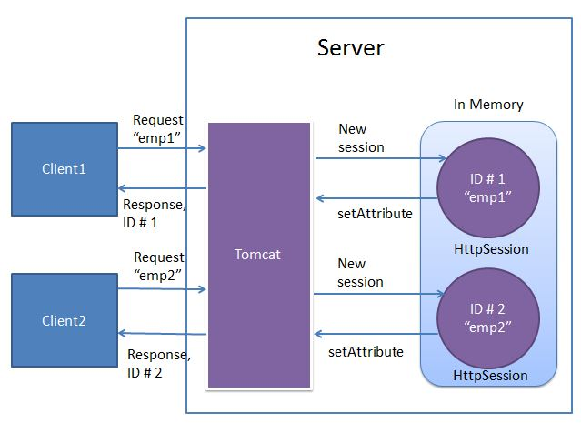

Slide 141
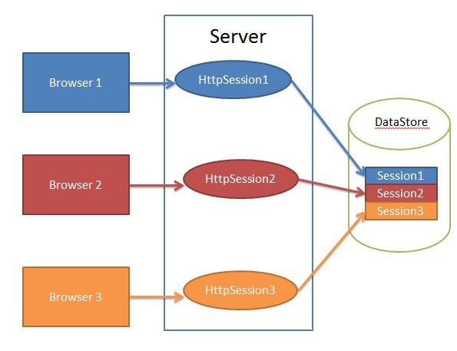

Slide 142
How to configure Maven Tomcat Plugin to use HTTPS (SSL/TLS)
Test
mvn tomcat7:run-war

Slide 143
Questions

Slide 144
Module Summary
Spring Integration Framework.
Message, Channel and Adapter
Understood the different Component Integration
Understood the Event-Driven Architecture

